Slide 1

Putting AI to work with IBM watsonx Level 1 course client presentation This is a derivative asset of the watsonx Client Briefing presentation available in LiveDoc and customizable for client engagements. Gina Hawkins Senior, Learning Content Development Gina.Hawkins1@ibm.com
Notes:
This is one of those rare moments in history when an innovative technology arrives that radically transforms business and society forever. That technology, of course, is artificial intelligence (AI), specifically, generative AI. IBM has a wealth of experience with AI, and an innovative technology roadmap to help clients looking to harness the power of AI to drive growth and create a competitive advantage. How most AI project failed in the past, it’s different now with generative AI models.
This presentation is for the watsonx Level 1 course. It provides an overview of the impact of generative AI, foundation models, and the AI solutions that IBM offers for businesses. IBM’s AI solutions include watsonx and it’s three components, watsonx.ai, watsonx.data, and watsonx.governance. In addition, IBM has introduced watsonx AI assistants which (as of October 2023) include watsonx Orchestrate, watsonx Assistant, and watsonx Code Assistant (for Red Hat Ansible Lightspeed and for Z).
Note: This watsonx Client Briefing presentation can be generated in LiveDoc and customized for client engagements. This course provides an activity and an overview video on how to build a custom presentation. Click the link to start building a custom presentation: https://ibm.seismic.com/Link/Content/DCb4B7pmb64cT82RJ8fpJQBHhjb8.

Slide 2
75%
The impact of generative AI | The opportunity
of CEOs say their competitive advantage rests on generative AI¹
“Generative AI models surprise, impress, and scare us, all at the same time.”
Gonzalo Gortázar
CEO, CaixaBank
Notes:
Companies around the world are recognizing the benefits of generative AI. When combined with automation technology, generative AI can help clients improve interactions with customers and partners, as well as boost operational efficiency and productivity. As a result, business leaders are increasingly asked how they use generative AI to transform their organizations.
The growing adoption of generative AI across industries reflects their crucial role in leveraging foundation models and large language models (LLMs) in the enterprise. This, in turn, is driving a new era of work and productivity across industries.
Generative AI’s impact on productivity will add up to USD 4 trillion in the global economy. To put that in perspective, the fifth largest economy by gross domestic product (GDP) in 2023 was about USD 3.7 trillion. However, at the end of 2023, most of generative AI was in the experimental phase.
IBM has a long history of leadership and innovation in the AI space. IBM first created Watson, which is specifically designed for AI for business in 2008. Since then, IBM has made great strides in productizing many of these innovations into real open-source applications that solve tangible business challenges enterprises are facing.
IBM has completed over 40,000 AI engagements since it’s debut and continues to work with over 85% of the Fortune 1000.
In 2023, IBM launched watsonx, an AI and data platform to power foundation models and generative AI for the enterprise. IBM is now managing 1,200 AI models worldwide, including country-specific requirements… and we’re just getting started.
Reference:
¹CEO decision-making in the age of AI, IBM Institute for Business Value (IBV), June 2023: https://www.ibm.com/thought-leadership/institute-business-value/en-us/c-suite-study/ceo

Slide 3






However, the following barriers prevent organizations from benefiting from AI
The impact of generative AI | The opportunity
Integration and scaling challenges
AI governance
Data complexity
High price
Limited skill and expertise
Lack of AI model development tools
Notes:
However, with the great promise of generative AI, comes new barriers. While many enterprises acknowledge the value of generative AI, based on the work that is being done with clients around the world and the IBM Global AI Adoption Index 2023,¹ the following barriers to benefitting from AI still exist:
AI projects that are too difficult to integrate and scale (22%)
ethical concerns (23%)
too much data complexity (25%)
high price (21%)
limited AI skills and expertise (33%),
lack of tools for AI model development (21%)
Reference:
¹IBM Global AI Adoption Index 2023: https://www.multivu.com/players/English/9240059-ibm-2023-global-ai-adoption-index-report/

Slide 4








The impact of generative AI | The opportunity
Physical Asset Management
Business Automation
Opportunity to unlock business advantage with foundation models trained across the breadth of enterprise data
Sensor/ IoT data
Business process data
IT Ops & IT Automation
Threat Management
IT data
Cybersecurity data
Molecular data
Foundation models
Sustainability
Geospatial data
Natural language
Code
App Modernization IT Automation
Customer Care Digital Labor
Notes:
Why is IBM focusing on foundation models (FMs) and large language models (LLMs)?
Think about the data that exists in every business around the world, whether it's sensor data, images, speech, different data about the business — this is all intelligence that's just waiting to be unleashed. This drives the work that IBM has been doing to understand what are the FMs that IBM should be building that will help clients differentiate themselves from their competition.
A FM is trained on large amounts of unlabeled data sets and uses self-supervised learning which can be adapted to new scenarios and use cases. Although a FM requires a significant investment up front, it amortizes the initial work of artificial intelligence (AI) model building each time it is used as the data requirements for fine tuning additional models built on the FM are significantly lower (10x – 100x). This leads to both a huge increase in return on investment (ROI) and much faster time to deployment.
FMs are already the norm in natural language processing (NLP), where a single prompt can instruct a generative model to perform a new task, from producing poetry to answering a customer service query. But language is only the beginning. IBM is building a set of domain specific FMs trained on multiple types of business data, including code, time-series data, tabular data, geospatial data, semi-structured data, and mixed modality data such as text combined with images. These models will empower applications ranging from code creation to drug discovery to cybersecurity and will dramatically impact how people interact with technology, changing not only how business is done, but how clients think about their business.
IBM believes that the flexibility and scalability of its FMs will significantly accelerate AI adoption. Instead of treating AI as a tactical “add on,” enterprises will now be empowered to put AI to work at the strategic core of their business.
Indeed, within two years, IBM expects FMs to power about a third of AI within enterprise environments. In IBM’s early work applying FMs with clients, IBM has watched clients time to value go up to 70% faster than with a traditional AI approach.
Terminology:
Geospatial data: Includes information related to locations on the Earth's surface, such as latitude and longitude coordinates and addresses. These factors go through a secondary process to assist in representing them on a map.

Slide 5
The impact of generative AI | The opportunity
Conversational access to employee support and customer service
Summaries of documents and conversations
AI-powered content generation
Generative AI is ushering in the age of the augmented workforce
Use chatbots that have been trained on a broad knowledge base to help employees do work or to respond to customer issues.
Transform text into personalized overviews that capture key points and facilitate handoffs to live agents.
Write blog posts, job descriptions, emails, and more. Generate and transform software code.
40%
performance improvement for a highly skilled worker compared with those who don't use generative AI¹
Work automation
AI-powered business intelligence
Information search and data extraction
Automate simple tasks. Receive guided support through complex processes and workflows that involve multiple business applications.
Classify and sort customer complaints, threats, and vulnerabilities. Perform sentiment analysis and segment customers.
Extract key points from content that has been stored as unstructured text. Search and identify essential information needed for compliance processes like financial audits and regulatory filings.
Source: ¹Harvard Business School
Notes:
Generative AI has ushered in a new era – where foundation models like large language models (LLMs) become indispensable to the needs of consumers, patients, employees, and experts. There is no doubt that most humans will be interfacing with personalized assistants daily.
Ultimately, this is the age of the augmented workforce, where knowledge workers use AI in every part of their job. Generative AI introduces a new form factor for how we are all going to be getting work done – from writing emails, supporting customers, automating work, and much more.
Harvard Business School found that highly skilled workers who use generative AI enjoyed as much as a 40% performance improvement as compared to those who don't use generative AI. ¹
Reference:
¹Navigating the Jagged Technological Frontier: Field Experimental Evidence of the Effects of AI on Knowledge Worker Productivity and Quality, Harvard Business School Technology & Operations Mgt. Unit Working Paper No. 24-013, September 2023: https://papers.ssrn.com/sol3/papers.cfm?abstract_id=4573321

Slide 6
+AI → AI+
Reinventing how work gets done
Notes:
AI has gone from a world where companies are thinking about running their business, plus doing some AI to help it (+AI), to a world that is AI first (AI+) to help the business. The leading companies for the next decade or two will be the ones that decide that they will be AI first (AI+). This single decision will dictate how they operate, how they work with employees, and how they work with their customers and suppliers. AI first (AI+), is today’s world.
In short, being an AI first organization means enabling businesses to be value-creators using AI as opposed to solely value users.

Slide 7
Reinventing how work gets done | +AI to AI+
Digital labor
Customer service
App development & IT operations
Three proven, high impact use cases as starting points with IBM
40%
improvement in process productivity¹
>90%
customer inquiries handled by AI assistant²
60%
software development content automatically generated by AI³
Results
Talent acquisition
Performance management
Employee data management
Employee communications
Learning and event management
Customer self-service
Case deflection
Agent intent efficacy
Agent assist
Mobile FAQ with answers
Automated code generation
Application discovery and analysis
Code refactoring
Code conversion
Code attribution
Promise of generative AI
Content generation, classification
Retrieval-augmented generation, summarization, classification
Summarization,
content generation
Train and tune relevant foundation models using company-specific HR data spanning hybrid environments
Train and tune relevant foundation models using customer specific datasets to improve customer satisfaction
Automate code generation and reduce cycle time for modernizing applications, based on requirements and business rules
Sources: ¹IBM HR use case, ²Generali Poland cases study, ³IBM CIO pilot
Notes:
Based on an analysis of IBM’s extensive success with enterprises across all industry sectors, this slide details the three leading use cases where generative AI can quickly drive real business results and outcomes and serve as an ideal starting point for many companies. These use cases have been a focal point for IBM because of the ubiquity of their value but, again, there are many more areas where IBM is applying (and works on) generative AI use cases.
Organizations have been working to automate and streamline their processes so they can be handed off to digital workers. Many human resource (HR) processes are excellent candidates for digital labor – from resume parsing, to sourcing and screening, to candidate-skills matching, and more – have benefited from and been closely aligned with automation and AI capabilities. In this new era, however, generative AI can deliver more, using targeted advisors and the use cases that benefit from it will continue to expand. For example, there are clients who have seen a 40% improvement in HR productivity, streamlining tasks such as talent acquisition and managing employees and performance.
Customer engagement analytics and AI-infused virtual assistants (intelligent chatbots) help clients provide a superior level of personalized customer service when and where a company’s customers want to communicate. AI helps cut costs, automate rote tasks, and free customer care reps to focus on higher value interactions… making for happier customers, employees, and businesses. There are many examples of organizations who have deployed virtual assistants using watsonx Assistant, who have seen over 90% of their customer inquiries handled by their virtual assistant without human interaction, thus freeing their customer care reps to focus on higher value interactions.
Generative AI has the power to transform the process of application development, modernization , and management through code generation, code explanation, code conversion from one language to another, defining modernization workflow, and other automated processes. IBM has developed watsonx Code Assistant, a generative AI solution to improve developer productivity and application (app) modernization. Internally, IBM has been using watsonx Code Assistant for Red Hat Ansible Lightspeed in its application modernization projects. In one of many pilot project, IBM was able to achieve 60% initial build of an Ansible Playbook using recommendations provided by watsonx.
This presentation provides further details on all three of these use cases detailed on this slide.
Terminology:
FAQ: frequently asked questions
References:
¹Creating the future of human resources, IBM, October 2022: https://www.ibm.com/case-studies/ibm-human-resources-watson-orchestrate
²Setting a new standard for customer support, Generali Poland, IBM, October 2023: https://www.ibm.com/case-studies/generali-poland
³Generative AI generated 60% of Ansible Playbook Content in IBM CIO Organization Pilot, IBM, October 2023: https://www.ibm.com/case-studies/ibm-cio-organization-wca

Slide 8
Reinventing how work gets done | +AI to AI+
Customer-facing functions and experiences
HR, Finance, and Supply chain functions
IT development and operations
Core business operations
IBM is actively engaging with enterprise clients across a broad set of business domains
Customer service
Empower customers to find solutions with easy, compelling experiences
HR automation
Reduce manual work and automate recruiting, sourcing and nurturing job candidates
App modernization, migration
Generate code, tune code generation response in real time
Threat management
Reduce incident response times from hours to minutes or seconds
90% customer inquiries handled by an AI assistant¹
40% improvement in process productivity²
60% software development content auto generated by AI³
Contain potential threats 8x faster⁴
Marketing
Increase personalization, improve efficiency across the content supply chain
Supply chain
Automate source to pay processes, reduce resource needs and improve cycle times
IT automation
Reduce automation development, identify deployment issues, avoiding incidents, optimize application demand to supply
Asset management
Optimize critical asset performance and operations while delivering sustainable outcomes
Client results and analyst studies
Reduce derivative content creation spend⁵
Reduce product origin traceability from days to seconds⁶
Reduce mean time to repair (MTTR) by 50%+⁷
Reduce unplanned downtime by 43%⁸
Content creation
Ex. Enhance digital sports viewing with auto-generated spoken AI commentary
Planning and analysis
Make smarter decisions, focus on higher value tasks with automated workflows and AI
AIOps
Assure continuous, cost-effective performance and connectivity across applications
Product development
Ex. Expedite drug discovery by inferring structure with AI from simple molecular representations
Scale live viewing experiences cost effectively⁹
Process planning data up to 80% faster¹⁰
Reduce application support tickets by 70%¹¹
Faster and less expensive drug discovery¹²
Knowledge worker
Enable higher value work, improve decision making, and increase productivity
Regulatory compliance
Support compliance based on requirements / risks, proactively respond to regulatory changes
Data platform engineering
Redesign the approach for data integration using generative AI
Environmental intelligence
Provide intelligence to proactively plan and manage impact of severe weather and climate
Reduce 90% of text reading and analysis work¹³
Reduce time spent responding to issues¹⁴
Reduce data integration time by 30%+¹⁵
Increase manufacturing output by 25%¹⁶
Sources for footnotes: See speaker notes
Notes:
This self-explanatory slide highlights the early use cases IBM has applied for various clients’ business process and operations, and their associated outcomes when generative AI is applied.
The purpose of this slide is to highlight that even in the early adoption of generative AI, there are many real-world practical applications that have business value.
Terminology
HR: human resources
AIOps: artificial intelligence for IT operations
References:
¹AI-based unified digital messaging amplifies the customer experience, Vodafone case study, Genesys, 2020: https://www.genesys.com/customer-stories/Vodafone
²Creating the future of human resources, IBM, October 2022: https://www.ibm.com/case-studies/ibm-human-resources-watson-orchestrate
³Generative generated 60% of Ansible Playbook Content in IBM CIO Organization Pilot, IBM, October 2023: https://www.ibm.com/case-studies/ibm-cio-organization-wca
⁴TalkTalk client story, IBM, April 2019: https://www.ibm.com/case-studies/talktalk
⁵Reduce derivative content creation spend: 80% reduction in content creation spend achieved by IBM marketing during a pilot of AI-generated content creation
⁶Blockchain in the food supply chain - What does the future look like?, Walmart Global Tech, November 2021: https://tech.walmart.com/content/walmart-global-tech/en_us/news/articles/blockchain-in-the-food-supply-chain.html
⁷When billions of mission-critical file transfers depend on you, How ExaVault maximizes uptime using Instana, IBM, November 2021: https://www.ibm.com/case-studies/exavault-inc
⁸The Business Value of IBM Maximo, IDC, March 2022: https://www.ibm.com/downloads/cas/7XM93NG9
⁹Acing the US Open digital experience, IBM, October 2023: https://www.ibm.com/case-studies/us-open
¹⁰The Total Economic Impact™ Of IBM Planning Analytics with Watson, Forrester, December 2021: https://www.ibm.com/downloads/cas/DNPPK7YY
¹¹SulAmérica’s app-driven digital transformation, IBM, February 2023: https://www.ibm.com/case-studies/sulamerica
¹²IBM Research uses advanced computing to accelerate therapeutic and biomarker discovery, IBM Research, June 2022: https://www.nature.com/articles/d43747-022-00128-z
¹³IBM Watson Discovery product claim: https://www.ibm.com/products/watson-discovery
¹⁴IBM OpenPages product claim: https://www.ibm.com/products/openpages
¹⁵Gartner Top 10 Data and Analytics Trends for 2021, Gartner, March 2021: https://www.gartner.com/smarterwithgartner/gartner-top-10-data-and-analytics-trends-for-2021
¹⁶Environmental intelligence

Slide 9
Enterprise considerations
Business leaders face challenges in scaling AI across the enterprise with trust
80% of surveyed business leaders see at least one of these ethical issues as a major concern¹
Explainability
Ethics
Bias
Trust
46%
48%
46%
42%
believe decisions made by generative AI are not sufficiently explainable
concerned about the safety and ethical aspects of generative AI
believe that generative AI will propagate established biases
believe generative AI cannot be trusted
Agree
Neutral
Disagree
Notes:
There are major factors inhibiting the adoption of generative AI for business. While businesses recognize AI’s power, about 80% of business leaders acknowledge ethical concerns with adopting generative AI. In general, enterprise concerns can be broken down into the following categories:
Explainability
There is a need for businesses to understand the data used to create a foundation model (FM) and the model’s output. This includes the type of data used to train and fine-tune the model, and who has control and access to update the model. Who might have changed the model and for what reasons?
Ethics
There are many concerns over ethical issues with generative AI and for good reasons. Companies need to uphold their hard-earned reputation and protect themselves from generative AI models that output hateful, biased, or unethical behavior which could be very damaging to the company, not to mention have legal ramifications. It may appear that generative AI models provide the desired result, but it does not mean it is compliant with many ethic standards (corporate and government), and various government regulations (for example, data privacy). As generative AI becomes more prevalent, there are likely to be more regulations. Clients want to work with vendors committed to the highest level of accountability, and responsibility in complying with regulations, and in upholding high ethical standards.
Bias
Bias is a type of error that can occur in a large language model (LLM) if its output is skewed by the model’s training data. For example, a model may associate specific traits or professions with a certain race or gender, leading to inaccurate predictions and offensive responses. This is a general issue with all AI models and generative AI is not immune from it. Because of the way generative AI models are trained and used, it is even more important and at the same time more difficult to identify and mitigate bias. There is a concern that generative AI will simply propagate established bias, or even magnify it. There is a strong (and emerging legal) requirement that the models must be checked for bias before being released and automatically monitored for bias once released.
Trust
Clients are concerned that generative AI models cannot be trusted. Without trust, generative AI can be no more than a powerful and interesting chatbot. There are two aspects for clients to consider: data being entered into generative AI must not be used for any other purpose aside from prompting and training the model and outcomes from the model need to be trusted – trained on curated data, explainable, transparent, and monitored.
Other concerns
Hybrid and multicloud capabilities: Clients that need to observe straight data/application locality will need a hybrid platform, and multicloud options to avoid vendor lock-in.
Customization: Generative AI on FMs work reasonably well, but not for specific enterprise tasks as enterprises have very specific data, business terms, business processes, and other in-house rules. The first question clients must ask is: “How can the model be adapted to support specific enterprise use cases?” The second question clients must ask is: “What tools are available for the enterprise to hone/train the model?” The AI tools a company depends on must have guardrails, traceability, and transparency. Clients cannot just simply adopt FMs that cannot do what they need. Clients need to be able to trust an AI company with their data, reputation, customers, and above all, their businesses.
Reference:
¹Generative AI: The state of the market, IBM Institute of Business Value, June 2023: https://www.ibm.com/thought-leadership/institute-business-value/en-us/report/generative-ai-data-story (Click on Find the client-ready content here button then select Presentation deck: Generation AI State of the market.pptx.)

Slide 10
Enterprise considerations
What we’re learning from thousands of generative AI projects
Multi-model
Multi | hybrid cloud
Governance
Scale for value
Data matters
Two thirds of 150+ enterprises surveyed report pursuing a multi-model strategy
60% + of enterprises pursuing multi-model are experimental with commercial & open-source models
Commercial & open-source innovation
Quickly prioritize use cases that will outlive the model
Multi-modal (text, image, audio, etc.)
One model will not rule them all
Gartner reports that most enterprises will deploy generative AI across hybrid / multicloud environments
Run where the workflows, apps and data live
Infer where business runs to drive performance, cost, and simplicity
Data location to drive security benefits
Regulatory compliance to influence location selection
Surveyed companies report governance as a top requirement, impact of generative AI makes governance more difficult
Businesses must control bias and monitor drift
Organizations must actively monitor hallucinations and ensure model explainability
Leaders must seek practices and tools to ensure model and data provenance
Critical to pick the right use cases and deployment for generative AI ROI
Different work tasks have strongly positive or negative ROI impact
Time savings for a meaningful product innovation +40%; business problem solving -23% time needed
60+ points difference in value for work tasks
25x difference in cost per inference, depending on model and deployment
Generative AI pilots have not made it to production due to challenges with data quality, access, and security
Short run: model innovation creates value
Long run: data quality will decide which enterprises win with generative AI
Notes:
Organizations are increasingly turning to generative AI solutions to gain a competitive edge and unlock new opportunities. As AI adoption accelerates across enterprises, it becomes increasingly crucial to navigate the landscape carefully and responsibly.
Implementing AI is a complex process that requires careful planning and consideration. Businesses must ensure they integrate with existing systems, select the right AI models, consider ethical implications, define the problems they want to solve and scale, and ensure that their data is of high quality.
This self-explanatory slide lists what we’re learning as enterprises look to put AI to work in the most effective and responsible way possible.
Terminology:
ROI: return on investment
References:
Multi-model: Internal data from IBM conducting interviews to understand enterprises’ foundation model strategy decisions.
Multi | hybrid cloud: “How a Hybrid Platform Can Help Enable Trusted Generative AI,” Harvard Business Review, August 2023: https://hbr.org/sponsored/2023/08/how-a-hybrid-platform-can-help-enable-trusted-generative-ai
Governance: The CEO’s guide to generative AI, IBM Institute for Business Value (IBV): https://www.ibm.com/thought-leadership/institute-business-value/en-us/report/ceo-generative-ai
Scale for value: “Decoding the True Cost of Generative AI for Your Enterprise,” LinkedIn, Maryam Ashoori, PhD: https://www.linkedin.com/pulse/decoding-true-cost-generative-ai-your-enterprise-maryam-ashoori-phd

Slide 11
Enterprise considerations
Why IBM?
Open
IBM’s AI is based on the best open technologies available
Trusted
IBM’s AI is transparent, responsible, and governed
Targeted
IBM’s AI is designed for enterprise and targeted at business domains
Empowering
IBM’s AI is for value creators, not just users
Notes:
Businesses want a holistic strategy – one that embraces traditional AI and generative AI – tailored to the enterprise. IBM has four core principles on some vital characteristics of generative AI and foundation models (FMs) used for business. Specifically, it should be:
Open – IBM watsonx.ai is a hybrid cloud-native stack built on Red Hat OpenShift. This allows watsonx to integrate easily with other IBM cloud services such as Watson Studio, Watson Knowledge Catalog, Watson Query, and more. It also means watsonx.ai is hybrid and multicloud enabled. IBM’s partnership with Hugging Face provides clients with access to the best collection of open-source FMs available.
Trusted – IBM has a long history of building secure AI and data platforms. This focus is carried over to watsonx.ai to ensure IBM’s suite of FMs are built on the principles of trust, making them ready for business applications. IBM’s models are trained on highly curated, scrutinized, and strong efforts to only include copyright-free data and filtered to weed out inappropriate content. There are well-known issues with generative AI platforms (like ChatGPT and Google Bard), with hallucination (making up answers). Generative AI platforms need to be architected with governance in mind from the start, not an afterthought, and provide transparency and explainability for their models to support increasing regulatory compliance demands. The integration with watsonx.governance provides a trusted pathway to operationalize AI confidently and at scale.
Targeted – Watsonx.ai is designed for targeted business use cases to unlock new value for clients. Platforms like ChatGPT are not targeted, used for general consumption and trained on huge amounts of internet-supplied data that requires a large overhead to run (clusters of graphics processing units (GPU) nodes) and are expensive to run (inference) or to fine-tune. Enterprises should look for platforms that provide targeted models (or domain-specific models) for business use cases that can be quickly, effectively, and economically tuned with a small set of proprietary data from the business.
Empowering – Generative AI is not just about FMs, it must provide a platform that empowers enterprises to bring their own data to tune, train, and deploy generative AI models. The platform must also provide governance to ensure proper, responsible usage of the AI models. Moreover, it needs to be able to support running wherever the business wants to, at a desirable scale. Watsonx.ai is designed for AI value creators, not just users. Models can be tuned at a fraction of the cost (clients pick the right size, architecture, and domain) and they can use their own data and deploy anywhere.
Terminology:
Hallucination: A well-known phenomenon in a large language model (LLM) in which the system provides an answer that is factually incorrect, irrelevant, or nonsensical because of limitations in it’s training data and architecture.

Slide 12
What IBM offers
Introducing…
watsonx
Notes:
AI alone is not enough. All previous transformational technologies (from the steam engine to semiconductors) only truly unlocked productivity and innovation once they converged with other technologies. That’s why IBM has introduced an exciting new AI and data platform to scale and accelerate the impact of AI: watsonx. IBM watsonx represents five years of focused effort in the making.
Watsonx has been designed to address the businesses demand for AI to produce accurate and trustworthy results, that scale across hybrid clouds, and can be easily adapted to enterprise domains and use cases.

Slide 13
What IBM offers
Put AI to work with watsonx Scale and accelerate the impact of AI across your business.
watsonx AI and data platform
Leverage foundation models for generative AI and machine learning—tuned with your data wherever it resides, with responsibility, transparency and explainability.
watsonx assistants
Empower individuals in your organization to do work using AI assistants that are purpose-built, tailored for your business, automate end-to-end workflows and integrated into the core of your enterprise.
Notes:
This self-explanatory slide highlights watsonx, IBM’s AI and data platform and IBM watsonx assistants. These solutions help clients create real business value with trust, speed, and confidence.
The key to a client’s success is in the core of their business — the essential activities and capabilities that are fundamental to who they are and who they serve. Watsonx infuses core business operations with intelligence — it’s an AI and data platform to leverage foundation models (FMs) for generative AI and machine learning (ML) with AI assistants that make businesses and their employees more responsive, productive, and resilient.

Slide 14
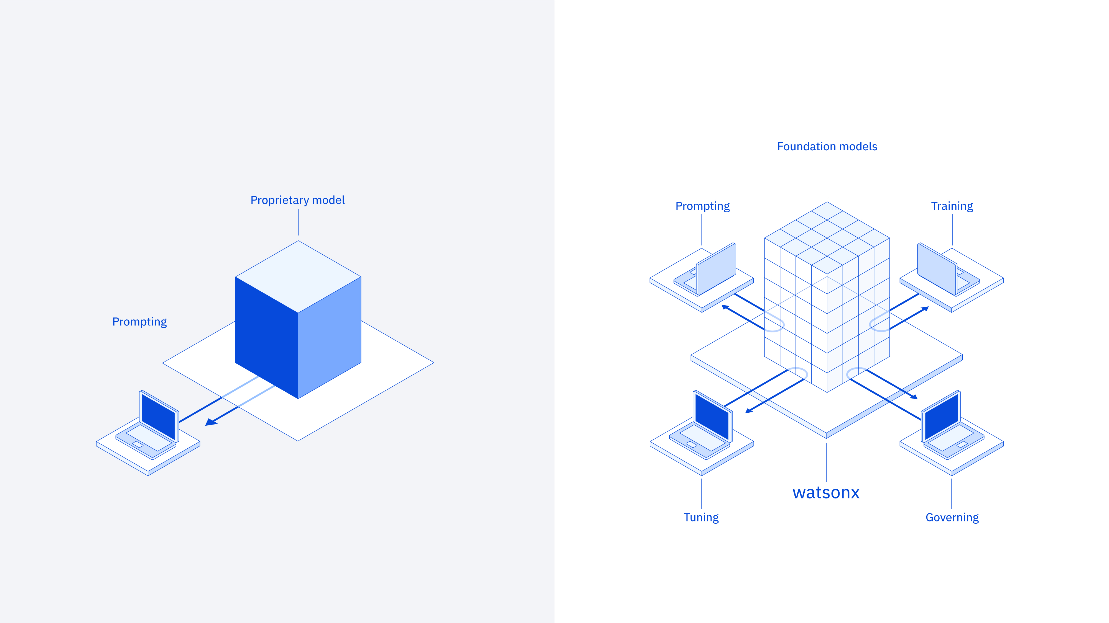
What IBM offers
AI user
AI value creator with watsonx
Train
Deploy
Tune
Validate
Notes:
Application programming interface (API)-based models have captured the public imagination, yet enterprises are firmly looking at more control. Many clients are looking to fine-tune open-sourced models or to build their own models to fulfill the needs for governance, latency, and regulatory requirements for their mission-critical workloads.
While other companies provide clients the API capabilities to become an AI user, IBM watsonx allows clients to go beyond just using AI to become an AI value creator. In watsonx, clients are not limited to just prompting someone else’s AI model with no control over the model or insight into the data. Instead, as value creators with watsonx, clients have multiple entry points. Clients can bring their own data and AI models to the platform to tune, train, deploy, and govern their AI.
The fact is that certain models will represent key intellectual property (IP) for enterprises. Clients bringing their own data and managing the lifecycle of those models and their use cases in-house becomes the difference between capturing or relinquishing market value. If clients’ data is used to retrain a model, clients want to make sure it is their IP. Foundation models (FMs), trained or tuned with client data, will become their most valuable asset. Clients should not outsource FMs or outsource their data. IBM watsonx enables clients to own their models and all the value they create for their business so they can control their own AI destiny.

Slide 15
What IBM offers
IBM’s generative AI technology and expertise
AI assistants
Empower individuals to achieve higher levels of performance by using generative AI to simplify access to information and automation across the business.
watsonx Code Assistant
watsonx Assistant
watsonx Orchestrate
watsonx Orders
Consulting
Generative AI strategy, experience, technology, operations
SDKs & APIs
Embed watsonx platform in third party assistants and applications using programmatic interfaces.
Ecosystem
integrations
AI & data platform
Leverage generative AI and machine learning — tuned with your data — with responsibility, transparency and explainability.
watsonx watsonx.ai
watsonx.governance
watsonx.data
Foundation models Granite | IBM Open Source | Hugging Face Llama 2 | Meta Geospatial | IBM + NASA …
Ecosystem
System Integrators, Software and SaaS partners, Public Cloud providers
Data services
Define, organize, manage, and deliver trusted data to train and tune AI models with data fabric services.
Cloud Pak for Data
watsonx Discovery
Hybrid cloud AI tools
Build on a consistent, scalable foundation based on open-source technology.
Red Hat OpenShift AI
(e.g., Ray, Pytorch)
Notes:
This diagram provides the big-picture context for how watsonx fits into IBM, but it also provides a high-level architectural view of how generative AI technologies fit into enterprises’ IT strategies and practices.
IBM’s generative AI tech stack includes all the components that enable businesses to operationalize AI. Specifically let’s look at the stack from the bottom up:
Hybrid cloud AI tools – IBM provides a scalable foundation to support the entire AI and data lifecycle. Watsonx.ai is powered by Red Hat OpenShift AI which provides a unified platform for businesses to scale workload demands of foundation models (FM). Hybrid managed run systems, on-premises or on the cloud… any cloud. Red Hat Open AI provides clients:
Certified and integrated open-source with technology building blocks (for example, PyTorch, Ray, TGIS, Caikit) for AI model inferencing and customization
Simplifies AI lifecycle management - extends OpenShift to provide a unified, extensible, and embeddable platform for data scientists and application developers, and IT Ops across the entire AI (ML/large language model (LLM)) lifecycle
Reduces complexity of incorporating AI at scale - to meet workload demands of foundation models and deliver consistency at any scale from cloud-to-edge deployments
Data services – An IBM data fabric helps clients build the right data infrastructure for AI. With this architecture, clients automate the discovery, management, and enrichment of data leveraging IBM data governance capabilities to deliver reliable data for AI workflows. IBM Cloud Pak for Data platform helps improve productivity and reduce complexity.
AI and data platforms – Watsonx is an AI and data platform designed to scale and accelerate the impact of AI by infusing intelligence into business operations. The watsonx platform is designed with the three most important components of an effective AI strategy: an AI studio, data, and governance. Watson.ai is a next generation enterprise studio for AI builders to train, validate, tune, and deploy AI models. Watsonx.data is an open, hybrid, and governed data lakehouse optimized for all data and AI workloads. And watsonx.governance allows clients to direct, manage, and monitor their organization’s AI activities, and employs software automation to strengthen a client’s ability to mitigate risk, manage regulatory requirements, and address ethical concerns.
Software development kits (SDKs) and application programming interfaces (APIs) – Programmatic interfaces that embed watsonx capabilities in watsonx AI assistants and applications.
AI assistants – Pre-built applications powered by watsonx. Clients can deploy watsonx AI assistants to do work without expert knowledge across a variety of business processes and applications, including automating customer service, generating code, and automating key workflows in departments such as human resources (HR).

Slide 16


What IBM offers
IBM hybrid cloud + AI platforms power business
watsonx
+
The industry’s leading unified hybrid cloud app platform
Enterprise-ready generative AI and data platform
A platform approach is the strongest enabler of digital transformation.
IBM offers flexible, secure, open, hybrid cloud, and AI platforms for a multicloud, multi-AI model world.
50%+ adoption
Open
Trusted
among Fortune 500 technology, aerospace & defense, financial, telco, and auto companies
Based on the best AI and cloud technologies
Built with governance, transparency, and ethics
468% ROI
203% ROI
Targeted
Empowering
Using OpenShift Cloud Services¹
Using OpenShift Platform Plus¹
Designed for targeted business use cases
Bring your own data and models, and run anywhere
AI runs on hybrid cloud – same base open-source tech; inference insights where business runs
Hybrid cloud is powered by AI – to manage complex IT environments; AI for AIOps; Security (XDR); and more
Notes:
This self-explanatory slide highlights IBM’s hybrid cloud and AI platforms, powered by Red Hat OpenShift and watsonx.
IBM watsonx.ai is powered by Red Hat OpenShift AI. Red Hat OpenShift, the industry's leading hybrid cloud application platform powered by Kubernetes (K8’s), brings together tested and trusted services to reduce the friction of developing, modernizing, deploying, running, and managing container-based applications. OpenShift delivers a consistent experience across public cloud, on-premises, hybrid cloud, or edge architecture.
Watsonx and Red Hat OpenShift AI together allow clients to:
Accelerate adoption of generative AI, foundation models and machine learning (ML) systems allowing organizations to quickly gain value from their data and respond to the business needs with innovative AI solutions.
Reduce the complexity and cognitive load of choosing the right tools required to operationalize foundation, generative AI and ML models at enterprise level and incorporating it to the business.
Simplify the process of managing the AI lifecycles with a platform that enables collaboration and streamlines serving, scaling, monitoring, and managing AI-enabled applications and ready-to-use models.
Reference:
¹Forrester Research

Slide 17





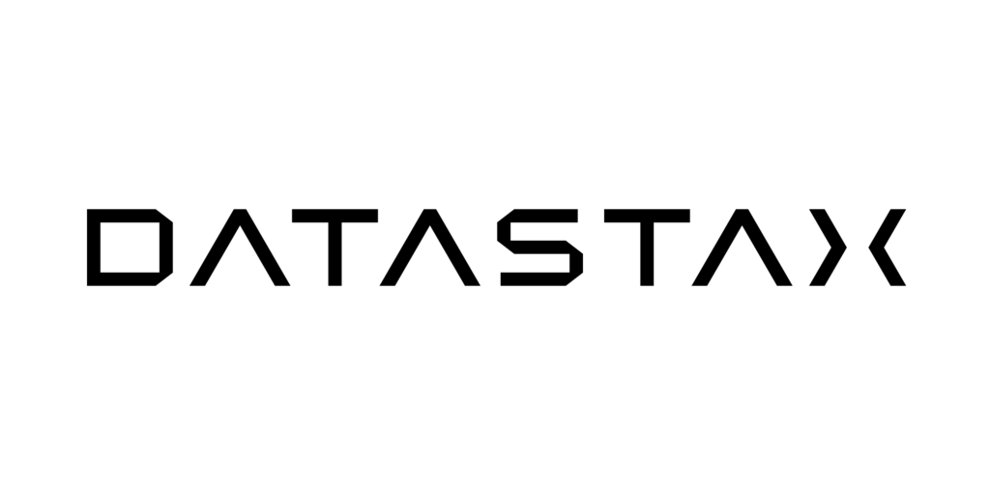




IBM Cloud Pak for Data
What IBM offers
Investments in an open and trusted data foundation will accelerate and scale your AI initiatives
Databases
Data Fabric
watsonx™
Scale and accelerate the impact of AI with trusted data
AI and Data Platform
watsonx.ai
watsonx.data
watsonx.governance
AI Assistants
watsonx Orchestrate
watsonx Assistant
watsonx Code Assistant
Store, unify, and share data with open formats and native integrations
Simplify data access across the enterprise and hybrid cloud environments with a data fabric architecture
Database
IBM Db2
IBM Informix
Data Governance
IBM Knowledge Catalog
Manta Data Lineage
Data Integration
IBM DataStage
IBM Data Replication
IBM Data Virtualization
Data
Delivering quality data to consumers and users
Data Warehouse
IBM Db2 Warehouse
IBM Netezza
Data as a Product
Delivering data products
Data Lakehouse
IBM watsonx.data
AI
Enabling data teams to be more productive with automated insights
Data Observability
IBM Databand
Master Data Management
IBM Master Data Management
3rd Party Databases
Any many more
Automated data lineage
Gain deeper visibility into your data and its journey from source to end-use for regulatory compliance and AI use cases with Manta, an IBM company.
Notes:
It is critical to deliver trusted data because AI is only as good as the data that fuels it. This dependency on data for successful implementations of AI, underscores the importance of the chief data officer’s (CDO’s) role in AI.
IBM enables clients to simplify access and consumption of data for AI workflows by leveraging an open and trusted data foundation. IBM provides native integrations across our databases portfolio and supports open formats such as Iceberg, enabling the ability to store, unify, and share data for analytics and AI without additional extract, transform, and load (ETL) or duplication of data. For example, Amazon Relational Database Services (RDS) for Db2 natively integrates with Db2 Warehouse and watsonx.data lakehouse on Amazon Web Services (AWS) to prepare transactional data for analytics and AI. Cloudera, Snowflake, Amazon Redshift, and any third-party analytics engine that supports Iceberg can now unify data and optimize workloads with multiple query engines in watsonx.data.
But that’s not enough. Customers have databases from a lot of different sources and fit-for-purpose databases across every database type. For that, you need a data fabric. With a data fabric architecture, clients can automate discovery and enrichment of data with our centralized data governance capabilities, enable data observability across various pipelines, employ various data integration styles, and management of data quality to deliver reliable data for AI workflows. This feeds watsonx, where all of a client’s AI workloads can be executed with trusted and high-quality data.
With the IBM data fabric architecture, clients leverage a unified platform that makes all data — spanning hybrid and multicloud environments — available for AI workflows; this composable and modular architecture provides the flexibility for clients to utilize the pertinent capabilities they need, while maximizing their existing infrastructure.

Slide 18
watsonx
What IBM offers
watsonx.ai
Train, validate, tune, and deploy AI models
watsonx.data
Scale AI workloads, for all your data, anywhere
watsonx.governance
Accelerate responsible, transparent, and explainable
AI workflows
The platform for AI and data
A next generation enterprise studio for AI builders to train, validate, tune, and deploy both traditional machine learning and new generative AI capabilities powered by foundation models. It enables you to build AI applications in a fraction of the time with a fraction of the data.
A hybrid, open data lakehouse to power AI and analytics with all your data, anywhere – supported by querying, governance, and open data formats to access and share data.
End-to-end toolkit for AI governance across the entire model lifecycle to enable responsible, transparent, and explainable AI workflows.
Notes:
Watsonx, the new IBM platform for AI and data is designed with the three most critical elements of an AI strategy in mind: data, governance, and an AI workspace. It empowers enterprises to train, tune, and deploy AI across the business, leveraging critical, trusted data wherever it resides.
This platform has three components:
watsonx.ai - A studio that clients can use to train, validate, tune, and deploy both machine learning (ML) AI models as well as foundation models (FM) for generative AI. This platform combines best-of-breed architectures with a rigorous focus on data acquisition, provenance, and quality, to serve enterprise needs.
watsonx.data - Makes it possible for enterprises to scale AI workloads using all their data with a fit-for-purpose next generation (multicloud and multi-engine) data lakehouse service optimized for governed data and AI workloads, supported by querying, governance, and open data formats to access and share data. Watsonx.data is based on open-source technologies, including Presto, Iceberg, Spark, and more.
watsonx.governance - Helps companies put AI into production by providing an end-to-end solution that encompasses both data and AI governance to enable responsible, transparent, and explainable AI workflows. AI governance helps business analysts understand the trustworthiness of their AI solutions.

Slide 19
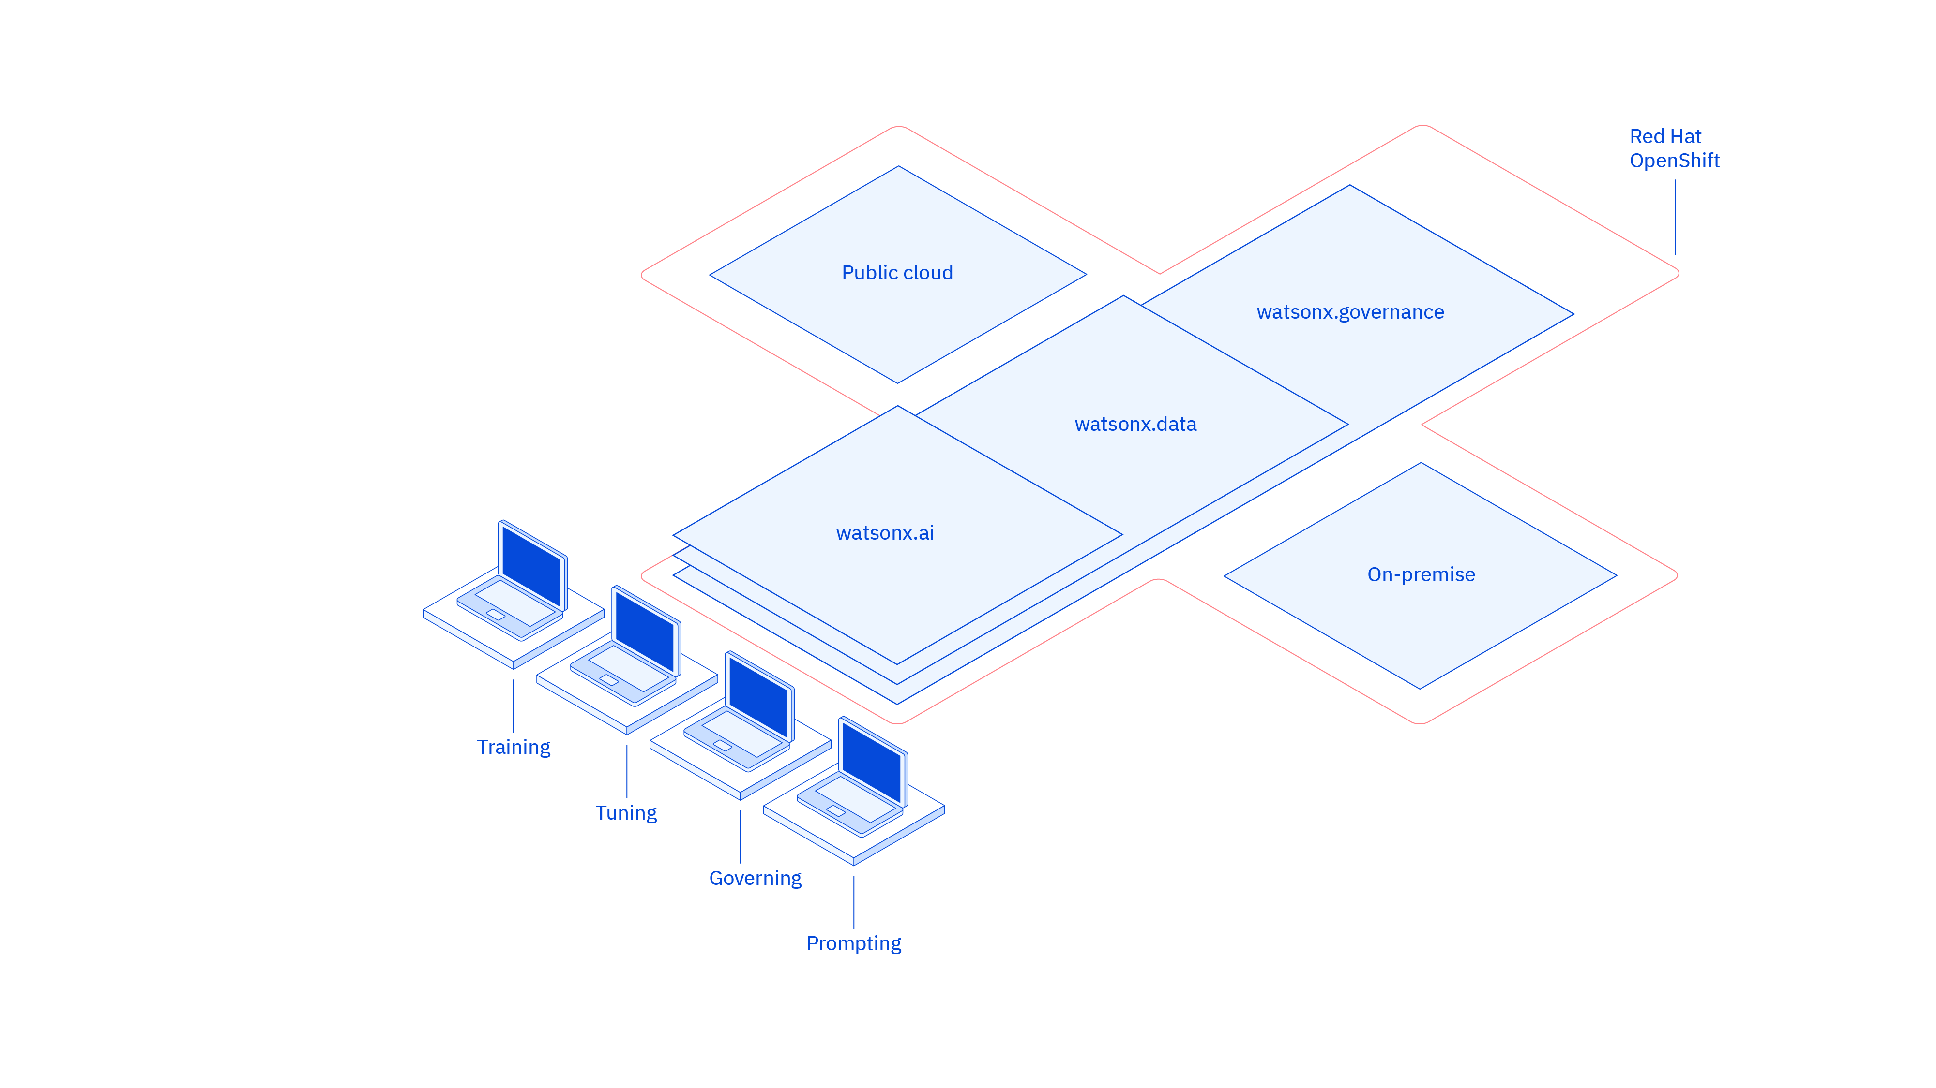
What IBM offers
watsonx: With flexible deployment based on Red Hat OpenShift
Train
Validate
Tune
Deploy
Notes:
True to IBM commitment with hybrid cloud architectures, watsonx is built on Red Hat OpenShift. Not only does it provide the seamless integration of watsonx components, but it also allows clients to access and deploy their AI workloads in any IT environment, no matter where they are located.
Businesses are demanding AI that produces accurate and trustworthy results, can scale across clouds, and can be easily adapted to enterprise domains and use cases. Watsonx is designed to help clients address those needs.

Slide 20
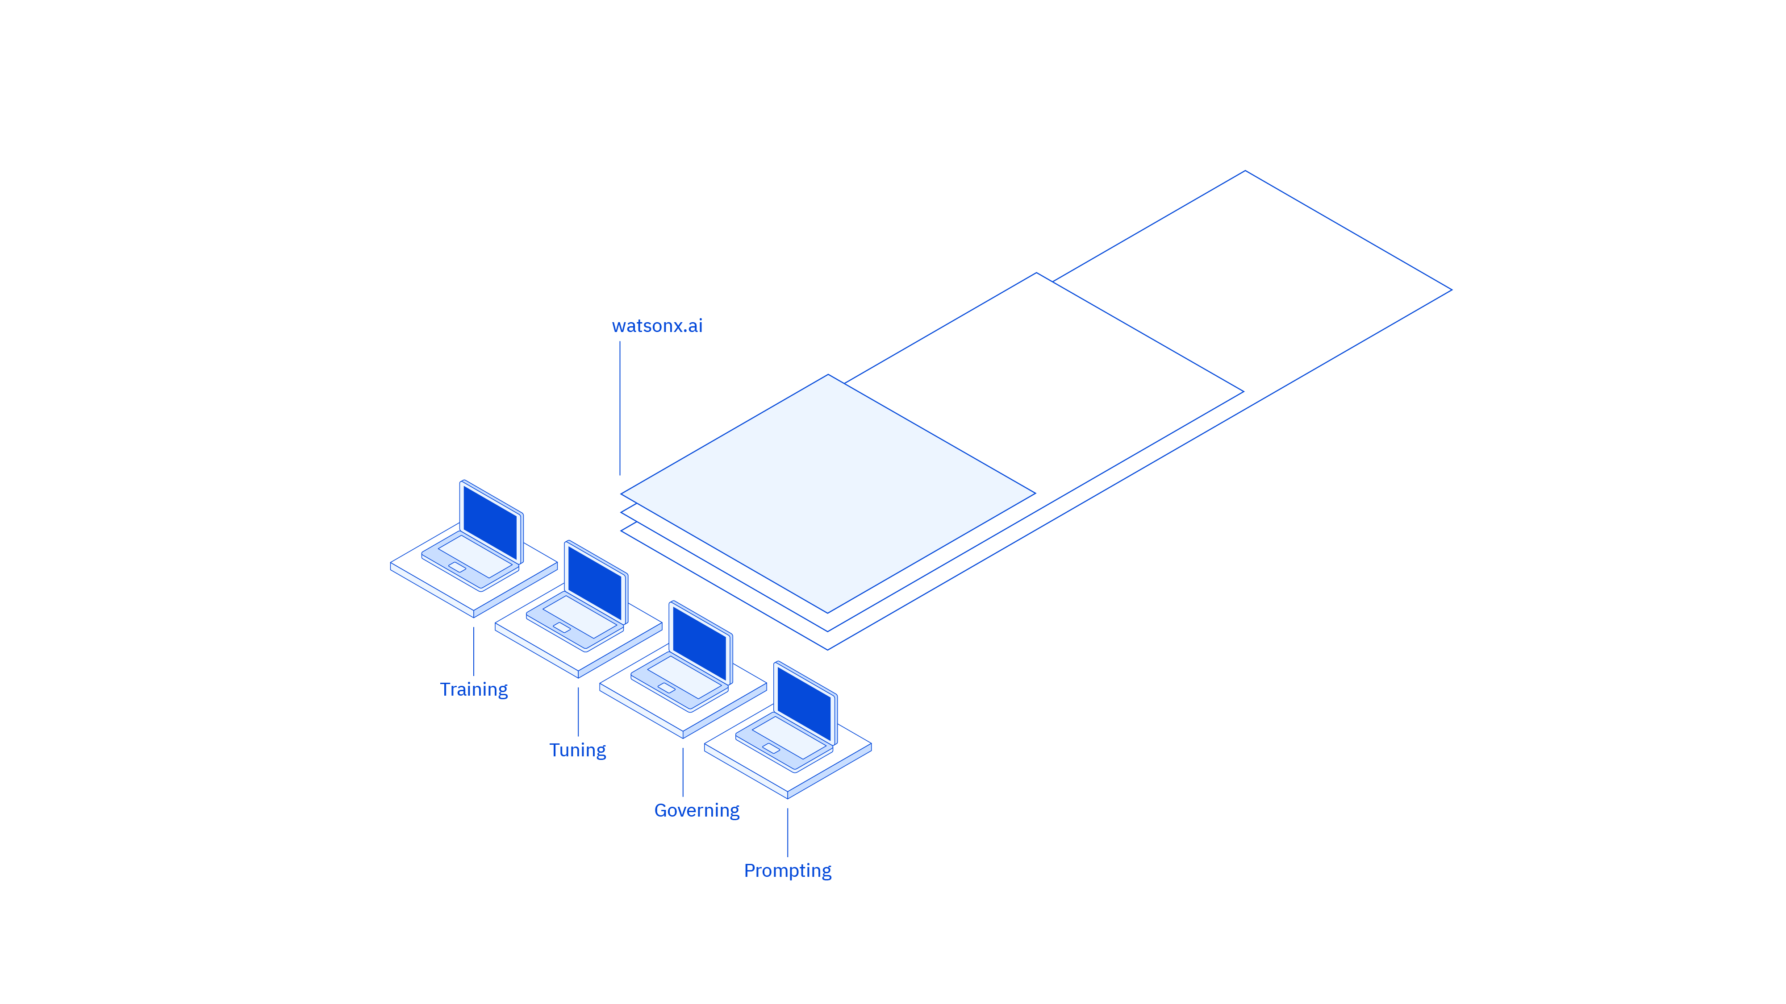
What IBM offers
watsonx.ai: An enterprise studio for AI builders
Foundation Model (FM) Library with IBM and open-source models
Prompt Lab to experiment with FMs by building prompts for various use cases /tasks
Tuning Studio to tune FMs with labeled data
InstructLab enables rapid LLM development with a novel approach to tune and train models
Data Science and MLOps to build ML models
Train
Validate
Tune
Deploy
Notes:
IBM watsonx.ai. is an enterprise studio to train, validate, tune, and deploy traditional machine learning (ML) and foundation models (FMs) that provide generative AI capabilities. IBM watsonx.ai components include a Foundation Model Library, a Prompt Lab, a Tuning Studio, and Data Science and Machine Learning Operations (MLOps) capabilities. Specifically:
Foundation Model Library - Clients have access to a family of IBM models of different sizes and architectures, IBM selected open-source models from the Hugging Face community, and other third-party models including Llama and StarCoder large language model (LLM) for code generation.
Prompt Lab - AI builders can work with FMs through prompts and experiment with zero-shot, one-shot, or few-shot prompting to support a range of natural language processing (NLP) type tasks including question answering, content generation, summarization, text classification, and extraction. This lab helps beginners to experts build, manage, and benchmark their prompts.
Tuning Studio - FMs can be further customized for better performance. Tuning can be useful to adapt existing models to domain-specific tasks (for example, learn new tasks or be very domain specific). Tuning also allows businesses to harness their proprietary data to differentiate their applications with focused, business data.
Instruct Lab enables rapid LLM development with a novel approach to tune and train models with new skills and knowledge, leveraging the best of the open-source community.
Data Science and MLOps - IBM provides all the tools, pipelines and runtimes powered by FMs a business needs to support building ML models automatically. Clients can automate their entire AI model lifecycle from development to deployment with connections to a variety of application programming interfaces (APIs), software development kits (SDKs), and libraries.

Slide 21
What IBM offers
watsonx.ai
IBM’s AI is open: based on foundation models that are multi-model on multicloud
Build your own models
Use IBM + open + other models
Try
Tune
Build and evaluate
Deploy on any cloud
Use IBM models
BYO Model
Notes:
IBM’s AI solution includes both traditional AI (IBM Watson Studio and Watson Machine Learning) as well as generative AI.
There are some important factors clients need to consider when implementing generative AI in their businesses:
One model will not rule them all. Instead of one model to address all use cases and performance needs, clients will benefit from many models — IBM models, open-source models, and client-tuned models. As clients participate in the creation process, they may need to build (or more likely fine-tune models) to create their own models. The global open AI community is incredibly vibrant and creative. It offers a wide diversity of innovations and models at an accelerated pace; and through IBM’s partnership with Hugging Face, IBM is incorporating the best open-source models, datasets, and libraries into the watsonx.ai platform to increase the value of foundation models (FMs) to clients’ businesses.
IBM is building “families” of FMs of different sizes, architectures and even domains, what’s more it’s providing multiple tuning methods from which clients can choose. IBM’s model architectures bring together cutting-edge innovations from IBM Research and the open research community to deliver performance, speed, and efficiency — architectures optimized for generative tasks, or for fine-tuning on specific tasks, for high inference efficiency and performance, or speed and effectiveness for enterprise natural language processing (NLP) tasks. These models can be customized for a range of enterprise tasks in customer care, digital labor, IT operations, cybersecurity, and more.
IBM’s strategy is to help clients infuse AI into their business processes, so it is important to have application programming interfaces (APIs), Python libraries, starter notebooks, and a software development kit (SDK) to provide easy and simple entry points for new generative AI users, and for data scientists to quickly determine how to exploit FMs and generative AI.
With watsonx.ai, clients have a complete AI platform that empowers clients to train, validate, tune, and deploy their AI models, both traditional and generative.

Slide 22



What IBM offers
watsonx.ai
Helping enterprises custom-build AI solutions to suit their specific needs
Leveraging foundation models to make it easier to build AI applications for text and sensor data, to enable models that detect natural hazards and track changes to vegetation and wildlife habitat.
Leveraged watsonx.ai foundation models to train their AI to create tennis commentary. Generated informative and engaging video clip narrations for fans with varied sentence structures and vocabulary.
“Watsonx.ai allows us to slash delivery time from 3-4 months down to 3-4 weeks for many customer care use cases.”
__
“By integrating watsonx.ai capabilities with our data information sources, we can greatly improve service delivery.”
__
Marc Martina Owner, President/CEO Technology Dynamics, Inc.
David Tan CTO CrushBank Technology, Inc.
Notes:
Businesses are excited about the prospect of tapping foundation models (FMs) and machine learning (ML) in one place, with their own data, to accelerate generative AI workloads.
IBM watsonx.ai is helping companies tailor AI solutions to suit their specific needs.
NASA: Collaborated with IBM to train a geospatial FM using watsonx.ai and the IBM Cloud Vela supercomputer. This FM was released as an open-source asset on Hugging Face. Specifically, this model was trained using NASA’s extensive set of sensor data collected by its network of satellites and can be used to detect natural hazards and trac changes to vegetation and wildlife habitat.
Wimbledon: IBM worked with Wimbledon tennis championship to use FMs to generate tennis commentary based on live collection on match statistics. This generated text was used as informative and engaging video clip narrations for fans and used varied sentence structures and vocabulary.
Technology Dynamics, Inc. (TechD): Marc Martin, President and CEO, TechD, a leading services implementor in the data and AI space, notes how they look forward to collaborating with IBM to implement and iterate generative AI use cases across businesses. Martin states, “IBM watsonx.ai brings value and choice to the playing field. Many companies today have already banned some generative AI vendors and products by name. Having controlled, governed, and proven models - that can even run offline - is critical to our ability to deliver. Having watsonx.ai to ease the organizational and contractual concerns and accelerators like NeuralSeek to speed implementation and maintenance time allow us to slash delivery time from 3-4 months down to 3-4 weeks for many customer care use cases."
CrushBank Technology, Inc.,: A leader in the AI knowledge management space providing services to transform IT support, teamed up with IBM to explore multiple use cases leveraging the generative AI and FM capabilities of watsonx.ai. David Tan, CTO, CrushBank Technology notes, "We are especially interested in leveraging the summarization features in watsonx.ai to greatly improve service delivery. Providing IT agents with a comprehensive and accurate information source quickly and reliably eliminates the need to go through multiple documents manually. Integrating watsonx.ai capabilities with our data information sources, we can correlate and summarize information from various documents, delivering concise natural language answers.”
References:
IBM Brings Generative AI Commentary and AI Draw Analysis to the Wimbledon Digital Experience, IBM, June 2023: https://newsroom.ibm.com/2023-06-21-IBM-Brings-Generative-AI-Commentary-and-AI-Draw-Analysis-to-the-Wimbledon-Digital-Experience
IBM and NASA team up to spur new discoveries about our planet, IBM, February 2023: https://research.ibm.com/blog/ibm-nasa-foundation-models
IBM and NASA Open Source Largest Geospatial AI Foundation Model on Hugging Face. IBM, August 2023: https://newsroom.ibm.com/2023-08-03-IBM-and-NASA-Open-Source-Largest-Geospatial-AI-Foundation-Model-on-Hugging-Face
TechD, CrushBank and more watsonx client quotes: https://www.ibm.com/watsonx/resources/client-quotes

Slide 23
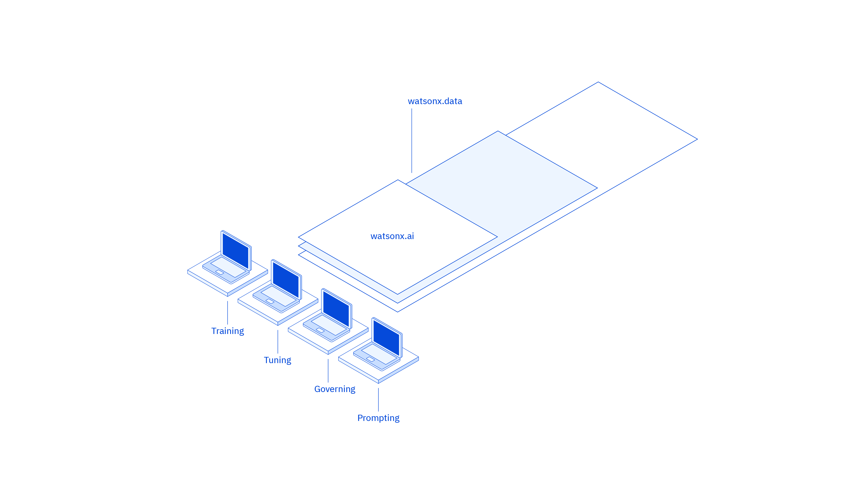
What IBM offers
watsonx.data: Enabled by a hybrid, open data lakehouse to power AI and analytics with all your data, anywhere
Train
Validate
Tune
Deploy
Notes:
IBM watsonx.data. is IBM’s massive, curated data repository that is ready to be tapped to train and fine tune models, with a state-of-the-art data management system.
Watsonx.data makes it possible for clients to scale analytics and AI with a fit-for-purpose hybrid, open data lakehouse, built on a next-generation (multicloud and multi-engine) architecture, supported by querying, governance, and open data formats to access and share data. With watsonx.data, clients can connect to data in minutes, quickly get trusted insights, and reduce their data warehouse costs. As of 4Q23, watsonx.data is available as a service on IBM Cloud and Amazon Web Services (AWS) and as containerized software for prompt deployment.

Slide 24
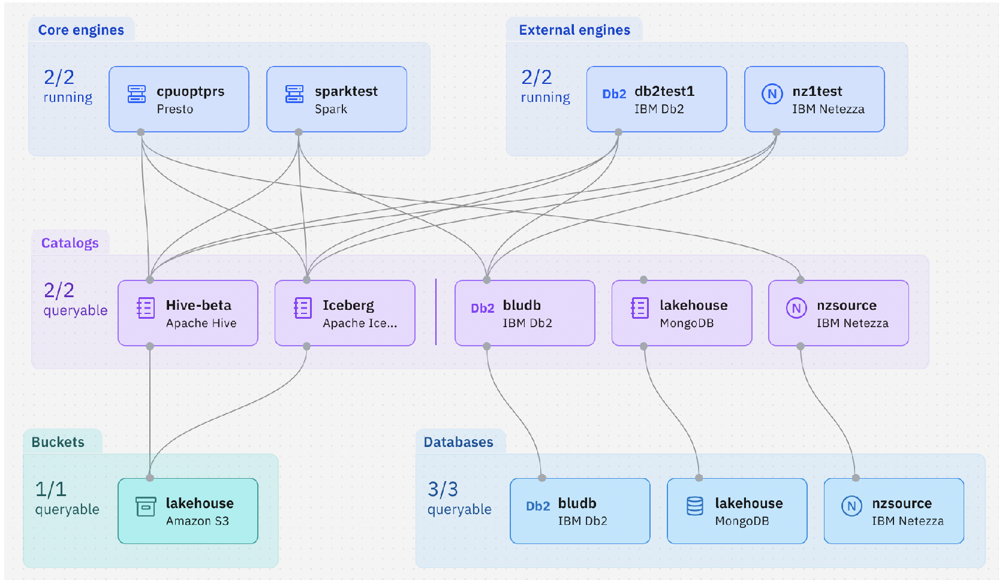
What IBM offers
watsonx.data Scale AI workloads, for all your data, anywhere
A hybrid, open data lakehouse to power AI and analytics with all your data, anywhere.
Access all your data through a single point of entry across all clouds and on-premises environments
Get started in minutes with built-in governance, security, and automation
Reduce the cost of your data warehouse by up to 50% through workload optimization across multiple query engines and storage tiers¹
IBM watsonx.data with Presto C++ 0.286 and query optimizer delivers a better price performance than the leading data lakehouse platform, with equal query runtime at less than 60% of the cost²
Notes:
With watsonx.data, organizations can optimize their analytics and AI workloads by selecting the right engine for the right workload at the right cost, anywhere — without having to copy data to multiple platforms and while taking advantage of integrated metadata.
With watsonx.data, clients can scale up or down automatically, optimizing costs and ensuring the right workload is running on the best engine for the job. Through augmenting workload optimization with watsonx.data, an organization can reduce data warehouse costs by 50 percent.¹ By sharing data on low-cost object storage between multiple analytics engines, watsonx.data can use fit-for-purpose engines for different workloads. For example, many AI and machine learning (ML) focused workloads are best suited to run on a Spark compute-optimized engine, whereas it’s likely the case that a business intelligence (BI) focused use case is better suited for the cache-optimized structured query language (SQL) Presto engine. Caching of data and metadata within Presto is provided by Alluxio and RaptorX. Caching not only eliminates the need to read frequently accessed data, but also reduces query latency by eliminating frequent calls to the metastore.
Clients should consider these questions to see whether a modern lakehouse architecture with watsonx.data can work with their data, and workloads, while saving money:
Is data being centralized into a data lake or in a data warehouse, on-premises or in the cloud?
Are their workloads today inside a data warehouse that don’t necessarily need to be there because they don’t need high performance, are staging tables, or another reason?
How are costs being managed and what is the performance of these architectures?
Reference:
¹When comparing published 2023 list prices normalized for virtual private cloud (VPC) hours of IBM watsonx.data to several major cloud data warehouse vendors. Savings may vary depending on configurations, workloads and vendors.

Slide 25
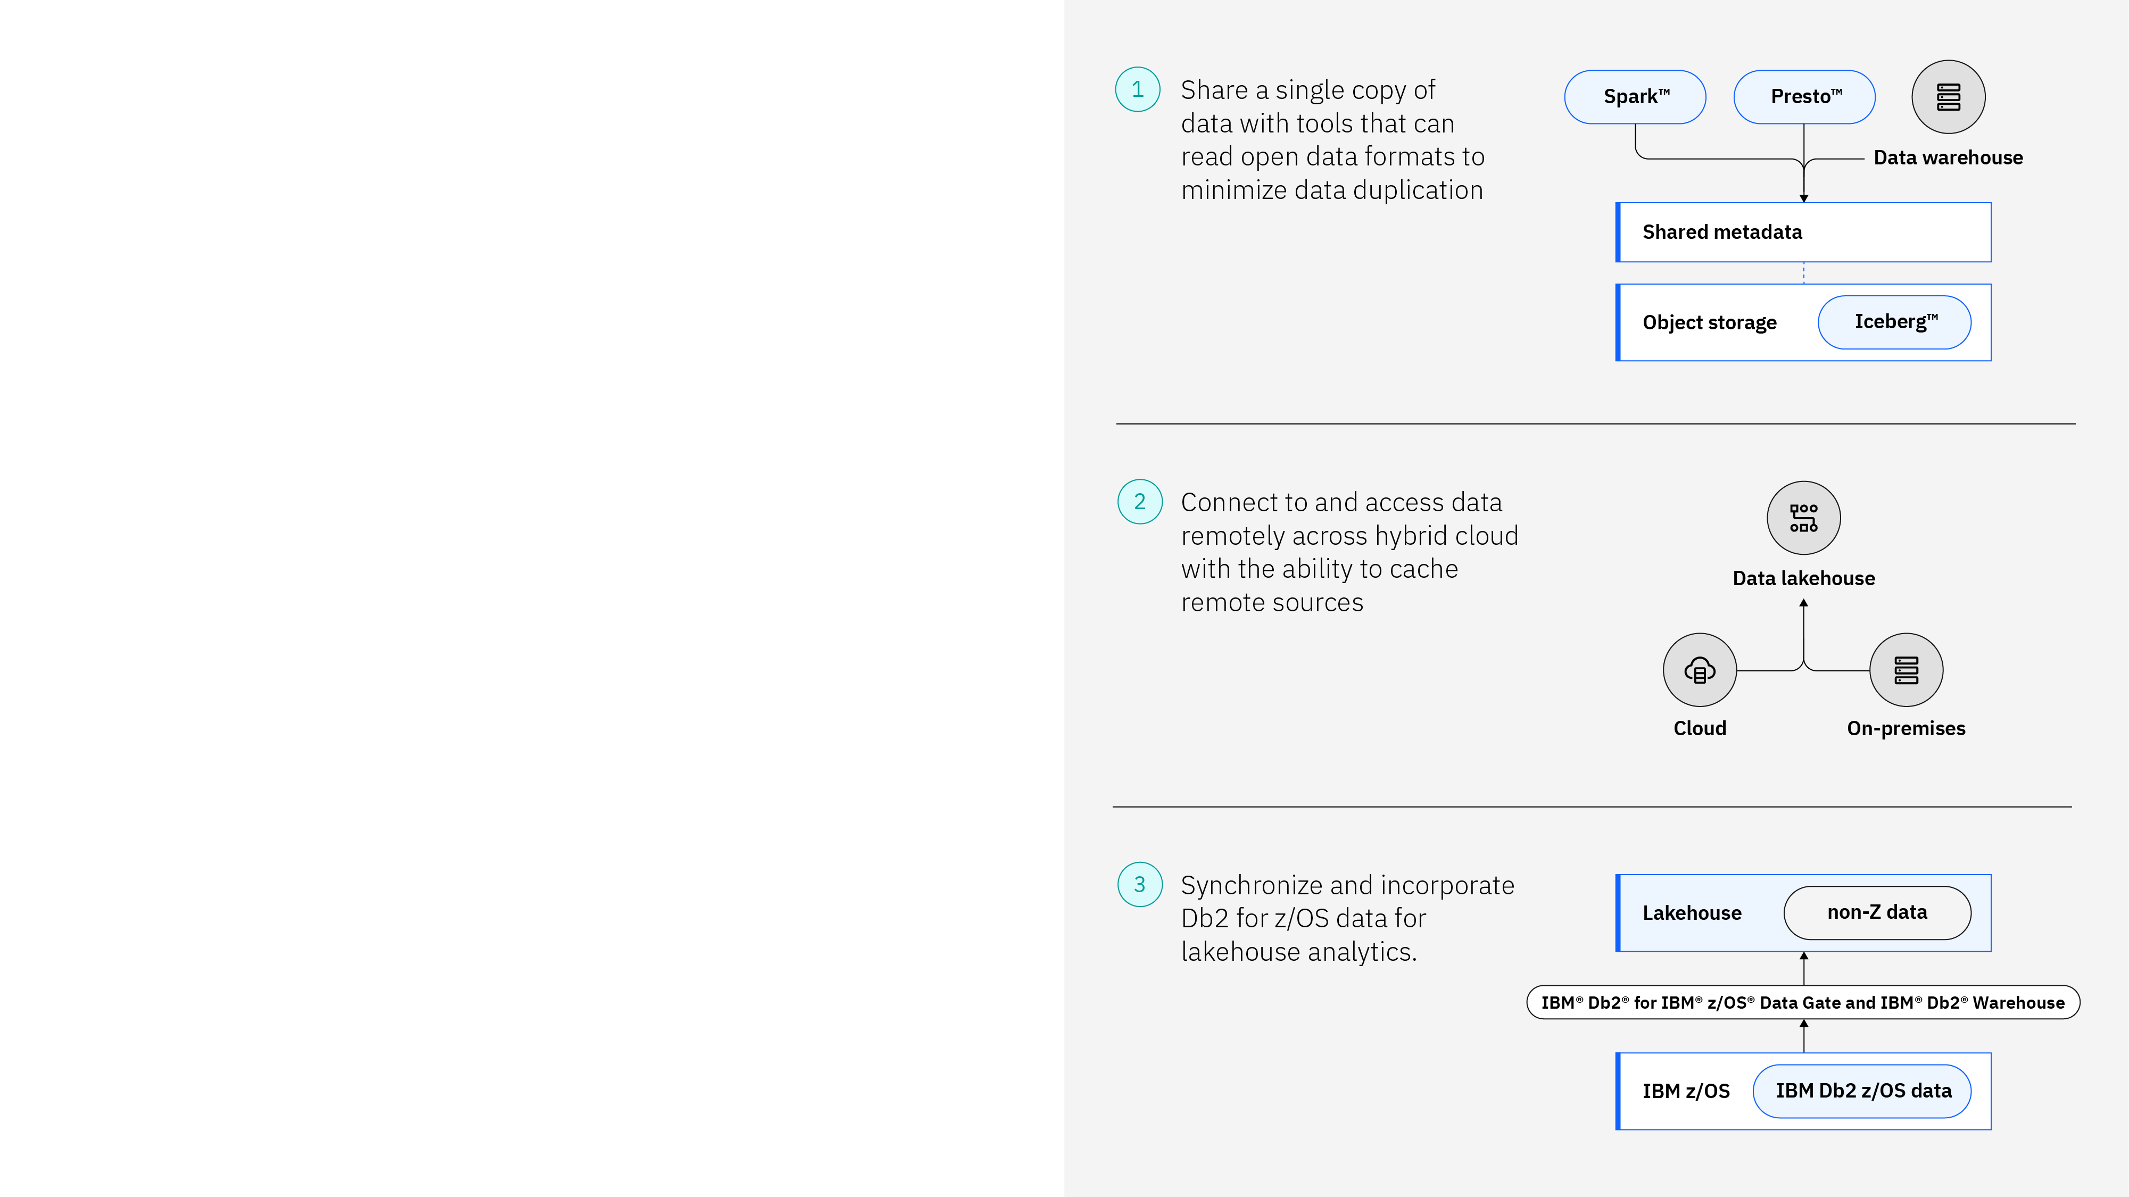
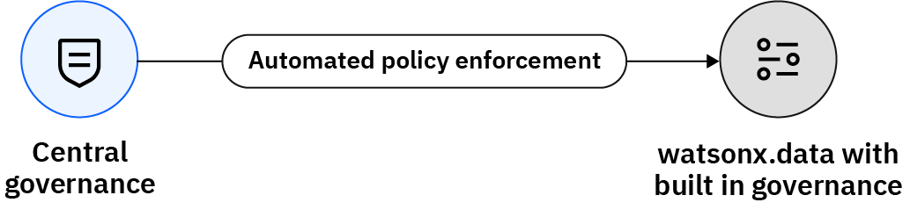


What IBM offers
Access all your data through a single point of entry across all clouds and on-premises environments.
watsonx.data
Scale AI workloads, for all your data, anywhere
A hybrid, open data lakehouse to power AI and analytics with all your data, anywhere – supported by querying, governance, and open data formats to access and share data.
Seamlessly deploy across any cloud or on-premises environment in minutes with workload portability through Red Hat OpenShift.
Reduce the cost of your data warehouse by up to 50%* through workload optimization across multiple query engines and storage tiers.
Unify, curate, and prepare data for AI
Vectorized embeddings
Milvus vector database
IBM watsonx.ai (or another AI tool)
*When comparing published 2023 list prices normalized for VPC hours of IBM watsonx.data to several major cloud data warehouse vendors. Savings may vary depending on configurations, workloads and vendors.
Notes:
No matter where a client’s data lives across the hybrid cloud, watsonx.data can connect and access that data remotely. By reducing data pipelines and simplifying data transformation, clients can seamlessly combine data from existing sources with new data in the lakehouse to unlock new insights, faster.
Watsonx.data leverages the Apache Iceberg open table format, shared metadata, and cost-effective object storage to share a single copy of data across multiple query engines (like Presto and Spark). This facilitates collaboration, minimizes duplication and can help to reduce security and governance risks by reducing the number of copies necessary to support different users and tools.
A key component of watsonx.data is the use of multiple query engines such as Presto and Spark. Presto is an open-source, distributed structured query language (SQL) designed for analytic queries against data of any size, that's fast, reliable, and efficient at scale. Apache Spark is an open-source, unified analytics engine for large-scale data processing and machine learning (ML) pipelines. With Spark, clients can run data engineering, data wrangling, data science, and ML workloads with data parallelism and fault tolerance.
In addition to these core engines (Presto and Spark), external engines that support the Iceberg open table format can also work directly with data in watsonx.data object storage. For example, Db2 and Netezza have been to enhanced to support the Iceberg format, which means Db2 and Netezza-based warehouse can participate in a watsonx.data lakehouse ecosystem as well, accessing the lakehouse data in object storage directly (just as Presto and Spark can). Additionally, consider the ever-important transactional data that many clients generate on IBM Z (mainframe), including data in Db2 for z/OS, IMS, and VSAM. With IBM Data Gate for watsonx, clients can derive greater value from their watsonx.data lakehouse and existing IBM Z investment. Data can be replicated to Iceberg tables in watsonx.data, where it can be analyzed independently, or it can be joined with existing data in the lakehouse, to support analytics and AI workloads.
Clients can bring their own data and stay in control of their data. To truly realize maximum business value from AI, it is crucial for organizations to provide their analysts, business users, and data scientists with self-service access to high-quality, trustworthy, governed data. In just a few clicks, a client can connect to their existing analytics environments and start deploying fit-for-purpose query engines with integrated metadata and storage. Businesses can protect data, manage compliance, and maintain trust with built-in governance, access controls, and enterprise security. Clients can integrate with IBM’s centralized governance capabilities for automatic policy enforcement, and enable responsible, transparent, and explainable data, and AI workflows across the enterprise.
By optimizing a client’s artificial intelligence (AI) and analytics workloads and selecting the right engine, for the right workload, at the right cost, organizations can reduce the cost of their data warehouse by up to 50% (when comparing published 2023 list prices normalized for virtual private cloud (VPC) hours of IBM watsonx.data to several major cloud data warehouse vendors; savings may vary depending on configurations, workloads and vendors.)
It’s clear how watsonx.data makes it possible for enterprises to scale analytics and AI, by providing a hybrid, open data lakehouse platform to power AI and analytics, with all of a client's data, anywhere. But not only is watsonx.data built for AI it’s built with AI. One such example of this is a capability called semantic automation, which lets business users interact with their data simply by using natural language statements and questions. With semantic automation, users can easily discover, augment, and refine data using self-service, conversational access without the need for coding or data engineering expertise.
Efficient data processing is crucial for applications that involve large language models (LLMs), generative AI, and semantic search. These applications rely on vector embeddings, a type of data representation that carries within it semantic information that’s critical for the AI to gain understanding and maintain a long-term memory it can draw upon when executing complex tasks. Vector databases offer optimized storage and querying capabilities for embeddings. Watsonx.data includes Milvus, a popular and highly scalable open-source vector database. With watsonx.data and Milvus, clients can unify, curate, and prepare vectorized embeddings for their generative artificial intelligence (gen AI) applications at scale across their trusted, governed data.
Acronym:
VPC = Virtual processor core

Slide 26




What IBM offers
watsonx.data
Helping companies scale their AI workloads
“We look forward to partnering with IBM to optimize the watsonx.data stack and contributing to the open-source community.”
"We’re excited to see how watsonx can help us drive predictive analytics, identify fraud and optimize our marketing.”
Das Kamhout VP and Senior Principal Engineer Intel
Bahaa’ Awartany Chief Data Officer Capital Bank of Jordan
“Customers will benefit from a truly open and interoperable hybrid data platform that fuels the adoption of AI.”
“We believe watsonx.data will help enterprises lower storage costs, optimize compute, and ensure seamless data management.”
Paul Codding EVP of Product Management Cloudera
Ashish Baghel CEO and Founder NucleusTeq
Notes:
IBM watsonx.data is helping companies scale their AI workloads for all their data, wherever it resides. This slide details some quotes from execution of some companies that look to watsonx.data to scale their AI workloads.
Intel: “We recognize the importance of watsonx.data and the development of the open-source components that it’s built upon. We look forward to partnering with IBM to optimize the watsonx.data stack, achieving breakthrough performance through our joint technological contributions to the Presto open-source community.”
- Das Kamhout, VP and Senior Principal Engineer, Cloud and Enterprise Solutions Group at Intel Capital Bank: "Working with IBM, Capital Bank of Jordan is excited to get started with watsonx to further enhance our machine learning (ML) and Al capabilities. Building on our already existing Netezza workloads we aim to see how watsonx can bring all of our data, including unstructured data, together in a single layer, to help drive predictive analytics, reduce customer churn, identify fraud and risky transactions, and optimize precision target marketing. With watsonx, Capital Bank of Jordan is excited to continue their Al journey and enhancing their internal processes and customer experience.”
- Bahaa' Awartany, Chief Data Officer, Capital Bank of Jordan
Cloudera: “Open data lakehouse architectures powered by the Apache Iceberg table format give organizations the flexibility to use fit-for-purpose analytical solutions to future-proof their data platforms for all workloads,” said Paul Codding, EVP of Product Management of Cloudera. “IBM and Cloudera customers will benefit from a truly open and interoperable hybrid data platform that fuels and accelerates the adoption of AI across an ever-increasing range of use cases and business processes.” - Paul Codding, EVP of Product Management at Cloudera
NucleusTeq: “IBM’s watsonx.data enables next-generation lakehouse architecture for data-driven enterprises. We believe watsonx.data capabilities will help enterprises to lower storage costs and optimize the compute while ensuring seamless data management capabilities across discrete systems to support all data engineering and analytics (AI/ML) needs.” - Ashish Baghel, CEO and Founder at NucleusTeq
Reference:
watsonx client quotes: https://www.ibm.com/watsonx/resources/client-quotes

Slide 27
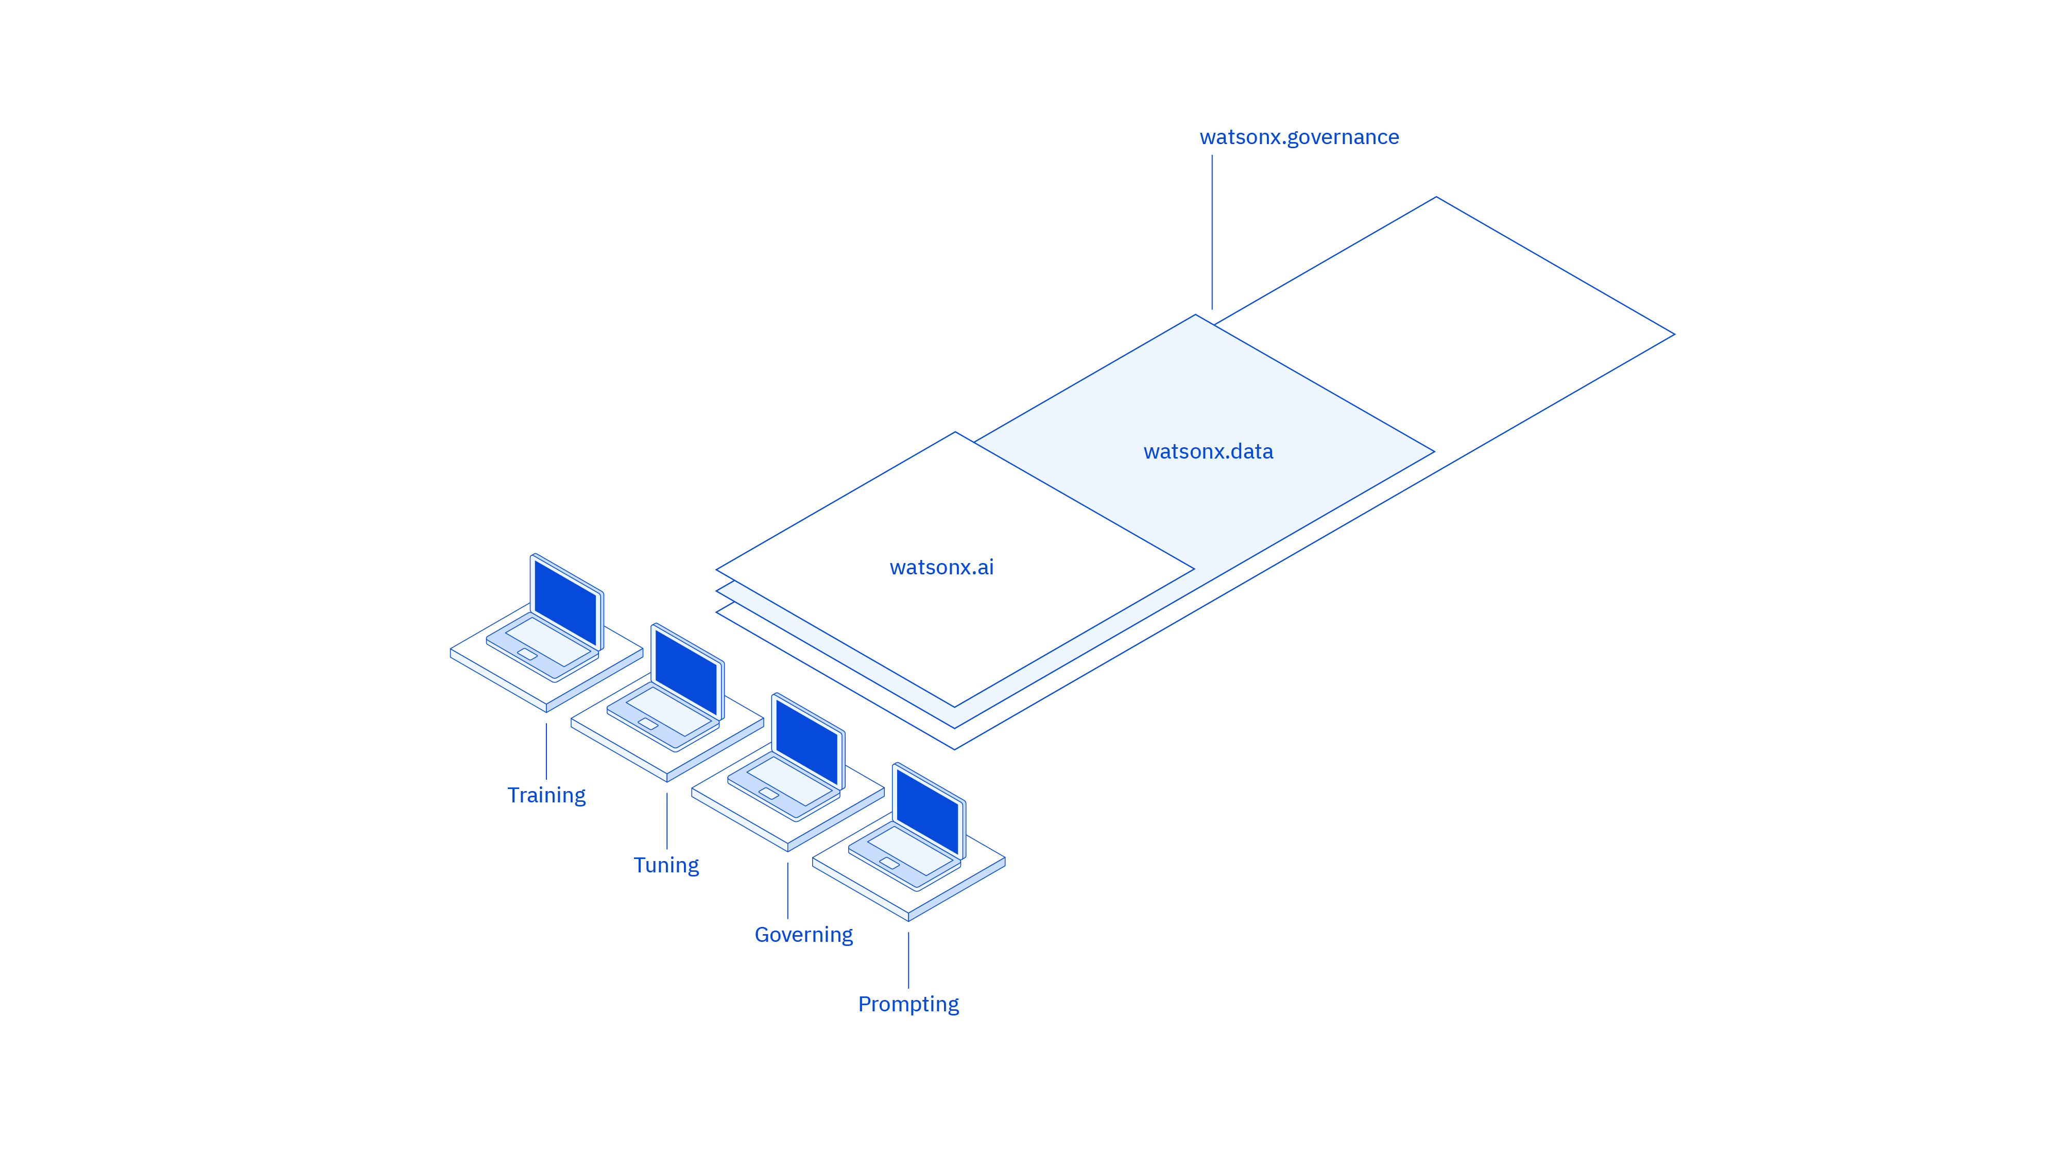
What IBM offers
watsonx.governance: Governed by responsible, transparent, and explainable workflows
Train
Validate
Tune
Deploy
Notes:
IBM watsonx.governance is a powerful set of tools to ensure a client’s AI assets are executing responsibly. As AI gets more and more embedded into daily workflows (this is what AI+ is all about), the greater the need for proactive governance to drive responsible, ethical decisions across a business. Watsonx.governance allows clients to direct, manage, and monitor their organization’s AI activities, and employs software automation to strengthen a client’s ability to mitigate risk, manage regulatory requirements, and address ethical concerns.

Slide 28
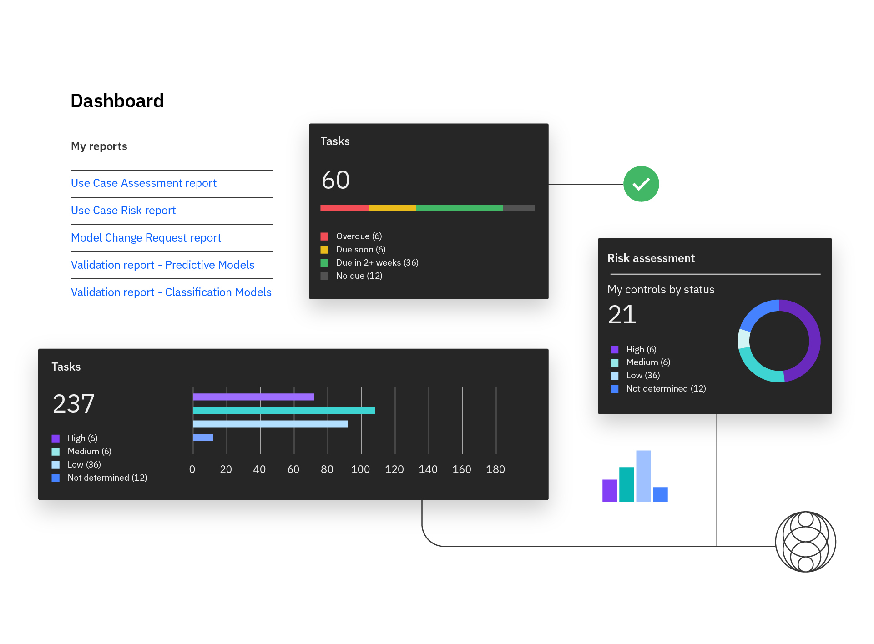
What IBM offers
watsonx.governance
Trusted: Accelerate responsible, transparent, and explainable AI workflows
A toolkit for AI governance to:
Manage AI to meet upcoming safety and transparency regulations and policies worldwide – a “nutrition label” for AI to respond to growing AI regulations
Proactively detect and mitigate risk, monitoring for fairness, bias, drift, and new LLM metrics to manage risk and reputation
Manage, monitor, and govern AI models from IBM, open-source communities, and other model providers to confidentially operationalize AI
Govern proprietary and third-party models across hybrid and multi-cloud environments
Notes:
Trust is an enterprise’s ultimate license to operate. The benefits of AI are moot if enterprises cannot have confidence in the predictions and content generated by the models. Clients must build responsibly, transparently, and put governance into the heart of the AI lifecycle. Many organizations are challenged with how to confidently operationalize AI across the AI lifecycle. Most organizations are using manual tools and processes for building, deploying, managing, and monitoring their models. This may work when building a single model as a proof of concept (PoC) but does not work when scaling AI across the enterprise and into production. Watsonx.governance provides the automated tools and processes necessary to shorten the model lifecycle, driving visibility and transparency.
Today, most AI models offered are trained on datasets of unknown quality and provenance. This can represent legal, regulatory, ethical, and inaccuracy nightmares. Data provenance and quality matters. Besides clients being able to bring their own curated datasets to watsonx.data, IBM, is carefully curating domain-specific and internet datasets as a first step to train trustworthy models. IBM cleanses those datasets and filters them for hate, profanity, biased language, and licensing restrictions before training. And IBM continues to develop and refine new methods to improve data quality and controls. Leveraging the capabilities of watsonx.data, IBM tracks and manages every step of the process from data acquisition to cleansing, filtering, processing, and training, allowing us to react and meet an evolving set of legal and regulatory requirements.
In watsonx.governance, IBM tracks the curated data, the methods used to curate it, and the models that each datapoint has touched so if anything changes in the future, it is easier to identify affected models and any data that may need to be removed, remove it, retrain the models, and repeat the lifecycle. Simply put, watsonx.governance helps clients govern the training data they use and the AI they deploy so that they can operate, scale, and succeed with trust as insurance.
With watsonx.governance clients can automate and consolidate multiple tools, applications, and platforms while documenting the origin of data sets, a model’s meta data, and pipelines. Automation helps eliminate tedious and time-consuming tasks of data scientists and model validators so they can perform their jobs more efficiently. Operationalizing AI also helps to increase the accuracy of predictions, decreasing drift and increasing the predictive accuracy of models by proactively identifying and mitigating bias, drift, and showing the need for model retraining. Automatic capture of the origin of data sets, model metadata, and pipelines drives transparency into how the model behaves in production.
IBM watsonx.governance provides the ability to monitor model quality and to detect and mitigate bias and drift in runtime so businesses can manage risk and protect their reputation. Thresholds are predefined by the business and used to establish alerts for the watsonx.governance risk management dashboard and customizable reports. Watsonx.governance provides an automated user-friendly toolkit spanning operations, model, and third-party risks. There is a single repository to maintain loss event data (for example, an irreversible physical event such as the release of hazardous material), risk assessment results, key risk indicators, issue management, and action plans related to the management of operational risk. Watsonx.governance provides for the tracing and documenting around AI model training, hyperparameters and metrics, and automates the documentation of the origin of data sets, model metadata, and pipelines, utilizing factsheets.

Slide 29
watsonx assistants
What IBM offers
watsonx Orchestrate
watsonx Assistant
watsonx Code Assistant
Purpose-built to increase productivity
Harness the power of AI and automation to free up individuals from tedious tasks
Build better virtual agents, to deliver consistent and intelligent customer care
Accelerate development, application modernization, and assist with IT operations
Tailored
Automated
Integrated
watsonx Assistant for Z
watsonx BI Assistant
Use generative AI to transform engagement and interaction with the mainframe
Get AI-powered insights in seconds from your personal business analyst and advisor
Notes:
This slide highlights IBM watsonx assistants (as of 2Q24): watsonx Orchestrate, watsonx Assistant, watsonx Code Assistant, watsonx Assistant for Z, watsonx BI Assistant (business intelligence assistant is in preview as of May 2024).
watsonx assistants are purpose built:
Tailored to your use case: Built on foundation models you trust, trained on best practices to accelerate results
Automate a range of high value tasks, across business processes and your IT estate: Support end-to-end workflows through automations - customize to your unique business requirements
Integrate with the core of your business: Work with different sources of data, workflows, and applications, anywhere
With watsonx Orchestrate, AI is tied with automation to help employees streamline an array of tasks and end-to-end processes so they can quickly offload time-consuming work to tackle more of the work only they can do. Business users can delegate common and complex tasks such as creating a job description, pulling a report in Salesforce or SAP SuccessFactors, sourcing candidates, and more using natural language.
Organizations have seen significant return on investment (ROI) from watsonx Assistant due to the ability to contain more conversations, accurately route calls, and help improve agent productivity. Understand customers in the right context, and provide fast, consistent, and accurate answers, and self-service support across any application, device, or channel. The intuitive build experience empowers everyone in the organization to build and deploy AI-powered virtual agents without writing a line of code.
Available as of October 2023, watsonx Code Assistant is a software development product that uses generative AI to empower developer teams by accelerating code generation. Increase developer productivity, reduce coding complexity, and accelerate developer onboarding. Purpose-built for targeted use cases, watsonx Code Assistant uses AI to support application modernization and IT automation.
New in 2024, watsonx Assistant for Z, a purpose-built assistant that enhances IBM Z professionals’ productivity by putting decades of experience and best practices at your teams’ fingertips to improve the way they engage with and manage the mainframe.
Currently in preview as of May 2024, watsonx BI Assistant, brings extraordinary analytics powers to ordinary business users. The platform is equipped to assess your data and the business context of your questions as well as provide insights you can dig into, act on and share. It interprets your key metrics and proactively raises alerts when anomalies are detected.

Slide 30






What IBM offers
Responds in a way that helps you accomplish your task, aligning systems, data and knowledge to achieve an outcome
Selects the best response to your request (e.g., provide information, execute a transaction, or generate an asset)
Interprets your requests with the appropriate context, prompting for additional information where needed
watsonx Orchestrate
Reimagine work to inspire a culture of productivity
Built on a foundation model platform you can put to work with models you can trust
Prepackaged with skills to accelerate time to value and boost employee and customer productivity
Democratizes access to AI and automation capabilities to achieve bigger ROI on existing investments
Proven results:
40%
improvement in process productivity¹
Source: ¹IBM HR use case
Notes:
IBM watsonx Orchestrate automates everyday work to help knowledge workers reimagine their jobs and unlock new levels of productivity. Knowledge workers can ask watsonx Orchestrate to complete simple tasks such as sending outreach emails, scheduling meetings, procuring approvals, and more.
For more complex business processes, watsonx Orchestrate can dynamically generate automation sequence in real time. The platform can connect with popular business applications, such as Salesforce, SAP, and Workday to quickly access and act on the information needed. IBM watsonx Orchestrate works alongside a business, it understands, guides, and learns from a business knowledge worker as work is done. With watsonx Orchestrate, clients unlock more hours in their day, more weeks in their year, and more value in their work. Quite simply, watsonx Orchestrate can return hidden hours to the business.
Terminology:
HR: human resources
References:
¹Creating the future of human resources, IBM, October 2022: https://www.ibm.com/case-studies/ibm-human-resources-watson-orchestrate

Slide 31

What IBM offers
Deliver frictionless customer experiences that scale across any device or channel using AI built on IBM watsonx large language and speech models that achieve higher levels of accuracy with less training
Accelerate the creation of AI assistants with an intuitive low-code user interface, pre-designed repeatable templates, and generative AI authoring
Optimize customer and employee experiences by delivering intelligent AI assistants that guide users with contextual, summarized answers
watsonx Assistant
Build and deploy AI assistants that scale across your business
Integrate with the tools, systems, and processes that power your business today… without migrating your technology stack
Empower your employees to experiment, analyze, and optimize an end-to-end customer experiences with built-in analytics tools
Enhance experiences with RAG powered by generative AI and the semantic search capabilities of watsonx Discovery
Proven results:
>90%
customer inquiries handled by AI assistant¹
Source: ¹Generali Poland cases study
Notes:
IBM watsonx Assistant is a conversational AI platform that combines powerful AI capabilities with an intuitive user interface (UI) that clients can use to build intelligent virtual assistants that scale across their business. It offers a no-code, (and low-code) easy-to-use interface for building and maintaining sophisticated virtual agents.
Powered by AI and watsonx foundation models (FM) that clients can trust, watsonx Assistant helps clients design virtual agents that can understand customers in context and provide fast, consistent, and accurate answers across any application, device, or channel.
Clients can leverage watsonx Assistant’s intuitive interface which provides an easy-to-use platform for their domain experts and technical teams to design, deploy, and manage sophisticated AI-powered virtual assistants — without needing a data scientist.
IBM watsonx Assistant empowers customer service teams to train it to tell, show, and do, so that it provides the optimal solution to the customer in each unique conversation, regardless of what channel they are on.
Clients can seamlessly connect to the processes, customer relationship management (CRM) systems, search tools, data sources, and contact center platforms that power their business — without migrating their technology stack.
Clients can also leverage analytics tools with easy visualization of critical metrics and key performance indicators (KPIs) that can help them understand the topics users and customers want addressed, whether their virtual assistant is meeting those needs, and how to quickly improve the service it provides.
Finally, clients can leverage enterprise search capabilities to enhance customer experiences with watsonx Discovery a search capability available as a priced, add-on option for watsonx Assistant. When coupled with retrieval augmented generation (RAG) via large language models (LLMs) on watsonx.ai, including the new IBM Granite model, it enables watsonx Assistant to provide conversational search.
Reference:
¹Setting a new standard for customer support, Generali Poland, IBM, October 2023: https://www.ibm.com/case-studies/generali-poland

Slide 32

What IBM offers
Accelerate code development through AI generated recommendations based on natural language processing requests.
Enhance the quality of code, with greater efficiency and improved accuracy
Bridge IT skills gaps by accelerating developer onboarding and enhancing proficiency in different programming languages without extensive upskilling.
watsonx Code Assistant
Write code faster with AI-generated recommendations based on natural language inputs
Reduce time to value through streamlined development cycles for application modernization and automation, guided by AI generated recommendations
Maintain high levels of accuracy and transparency through content source matching.
Tune the watsonx foundation model with your own data set to apply organizational best practices.
Proven results:
60%
software development content automatically generated by AI¹
Source: ¹IBM CIO pilot
Notes:
IBM watsonx Code Assistant is an innovative solution that uses generative AI to revolutionize software development and enhance developer productivity. Watsonx Code Assistant foundation models (FMs) are purpose-built for not just IT automation and coding. This creates a method where not only can this tool boost productivity, but also helps an organization share the intellectual knowledge in long-tenured developers and push that into the FM. Watsonx Code Assistant was designed to enable organizations to further customize and enhance its code recommendations by applying their own data sets and best practices to the model.
This solution enables developers of all skill levels to write syntactically correct code through AI-generated code recommendations, thus improving the quality of code. With watsonx Code Assistant as a programming partner, clients can lessen the burden of cognitive switching, reduce the complexity of coding, and reduce time to value.
IBM watsonx Code Assistant for Red Hat Ansible Lightspeed is developed in collaboration with Red Hat and IBM Research, infuses generative AI capabilities into Red Hat Ansible Automation Platform (AAP). It simplifies the process of Ansible playbook creation through “pair programming" with AI in the "navigator" seat, providing AI-generated recommendations.
The value of watsonx Code Assistant for Red Hat Ansible Lightspeed includes:
Developer can use natural language inputs in the Ansible task description to simplify the process of generating Ansible Playbooks to accelerate content development
Enable developers of all skill sets to have access to automation across more lines of business by generating code with natural language and plain English text, ultimately narrowing the IT skills gap
Meet automation developers where they work by integrating AI-content recommendations right in their integrated development environment (IDE). Organizations will experience a reduction in time to value for automation and improve development cycles
Maintain transparency to data sources for accuracy and accountability
IBM watsonx Code Assistant for Z primary objective is to leverage the combination of automation and AI to increase productivity and allow clients to expand the pool of talent available to work on mainframe (IBM Z) applications. The watsonx Code Assistant for Z application lifecycle is fully aligned with DevOps practices and leverages existing IBM Z DevOps investments. IBM initial innovation areas include application discovery, refactoring of business services, code transformation, and validation of generated code through automated testing.
IBM watsonx Code Assistant for Z helps accelerate application modernization by infusing AI and automation throughout the application lifecycle. From automated discovery, code refactoring and conversion, testing, and fit for purpose deployment, AI will play an important and increasing role. IBM watsonx Code Assistant for Z uses the power of generative AI to make it easier for developers to selectively modernize COBOL business services. Clients will be able to easily integrate refactored COBOL or Java code into existing COBOL applications running on IBM Z with full interoperability, while maintaining mainframe qualities of service. The result is a mainframe application modernization approach that is faster, lower cost, and less risk than today’s alternatives (migration, rewrite applications for a public cloud or manually convert applications).
IBM watsonx Code Assistant for Z leverages foundation models from IBM watsonx. Organizations can customize these models, while also applying their enterprise standards and best practices.
Reference:
¹Generative AI generated 60% of Ansible Playbook Content in IBM CIO Organization Pilot, IBM, October 2023: https://www.ibm.com/case-studies/ibm-cio-organization-wca

Slide 33







The value of the ecosystem
Open innovation
watsonx is an open data and AI platform to take advantage of the best AI and cloud technologies
Multi-model: use IBM, client proprietary, or open-source AI models
Multicloud: built on Red Hat for deployment portability
Continuous innovation: based on client engagement feedback, & IBM as client zero
IBM enhances the value of AI with the ecosystem
Expertise
IBM Consulting takes an open, multi-model AI and cloud approach combined with domain and industry expertise to reimagine enterprise workflows
Deep expertise: with IBM plus partner AI and cloud technologies
Client first: POV on which platform, model, and deployment option is best suited​
Experience-led approach: to business solution design
Deliver any AI model, on any cloud, anywhere - with expertise clients can trust
Extended value
IBM AI technologies complement business partners, to extend solution value
Embedded: watsonx is natively embedded in partner and IBM products (example: access IBM’s enterprise-grade AI capabilities in SAP’s leading ERP platform)
Integrated AI solutions and accelerators: that leverage IBM and partner models to address domain and industry use cases
IBM technologies are available and accessible: through partner marketplaces (example: AWS Marketplace, Salesforce AppExchange)
Notes:
This self-explanatory slide highlights IBM’s commitment to deliver AI on any cloud, anywhere, with expertise that clients can trust.
Terminology:
POV: point of view
AWS: Amazon Web Services

Slide 34






IBM works with strategic partners to help clients scale AI
The value of the ecosystem
Marketing transformation
Hybrid cloud and AI
Customer transformation
Driving productivity gains and personalized experiences at scale
Optimizing content supply chains with Adobe AI technologies
Embed watsonx into core Adobe Cloud platforms
Watsonx available on AWS as SaaS solution and AWS Marketplace watsonx.ai and watsonx.governance available by 2024
Expertise in Amazon, SageMaker, CodeWhisperer, and Amazon Bedrock
AWS to bring generative AI solutions and dedicated expertise to clients³
Unlocking the power of complementary AI and generative AI technologies
Extend the value of Salesforce platform with watsonx
Transforming customer, partner and employee experiences using generative AI²
Hybrid cloud and AI
Consumer experience
Core operations, industry solutions
Watsonx plans underway, today can be sold in a container to run on Azure
Microsoft Generative AI Center of Excellence
IBM Consulting Azure OpenAI Service available on Azure Marketplace - fully managed AI service to help with strategy, hackathon & implementation⁴
Samsung SDS America partners with IBM to introduce groundbreaking new solutions like SDS Zero Touch Mobility. IBM's launch of watsonx has inspired Samsung to explore the immense potential of watson.ai and it’s generative AI capabilities⁵
Launching new watsonx solutions to include the recently announced SAP generative AI assistant, SAP Joule
Building on recent work embedding Watson AI into SAP reaching 37,000+ SAP clients¹
Notes:
This self-explanatory slide details strategic partners that IBM is working with to help clients scale AI including SAP, Adobe, Salesforce, Amazon Web Services (AWS), Microsoft Azure, Samsung, and Oracle.
Refer to the source links below to read more about these strategic partnerships and the AI solutions offered.
Terminology:
AWS: Amazon Web Services
SDS: Samsung Data Services
References:
¹3 ways IBM and Adobe are transforming content supply chains with generative AI, IBM, August 2023: https://www.ibm.com/blog/3-ways-ibm-and-adobe-are-transforming-content-supply-chains-with-generative-ai/
²IBM Expands Relationship with AWS to Bring Generative AI Solutions and Dedicated Expertise to Clients, IBM, October 2023: https://newsroom.ibm.com/2023-10-18-IBM-Expands-Relationship-with-AWS-to-Bring-Generative-AI-Solutions-and-Dedicated-Expertise-to-Clients
³IBM and Salesforce Team Up To Help Businesses Accelerate Adoption of Trustworthy AI, Cision PR Newswire, August 2023: https://www.prnewswire.com/news-releases/ibm-and-salesforce-team-up-to-help-businesses-accelerate-adoption-of-trustworthy-ai-301914082.html
⁴IBM Consulting Global OpenAI offering: Strategy, Hackathon and Implementation, Microsoft Azure Marketplace, 2023: https://azuremarketplace.microsoft.com/en/marketplace/consulting-services/ibm-alliance-usa-ny-armonk-dtt-6418595.openai_hackathon_offering
⁵What Samsung is saying about watsonx.ai, IBM, July 2023: https://www.ibm.com/case-studies/samsung-client-quote
⁶SAP to Embed IBM Watson Artificial Intelligence into SAP® Solutions, IBM, May 2023: https://newsroom.ibm.com/2023-05-02-SAP-to-Embed-IBM-Watson-Artificial-Intelligence-into-SAP-R-Solutions

Slide 35


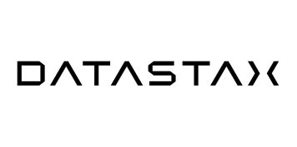




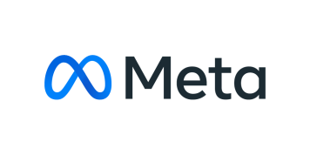


The value of the ecosystem
Leverage validated integrations of your existing technology investments and extend capabilities through the watsonx platform
Enables companies to quickly and responsibly scale AI workloads using a comprehensive stack of generative AI.
With IBM watsonx.data data store, you can optimize Cirata as a data warehouse with a shared metadata layer across all clouds and on-premises.
Seamlessly integrates with watsonx.data, enabling clients to access and share a single copy of data without duplication or the need for ETL.
Vector Search offers an integrated solution with IBM watsonx for contextual data, data pipelines, and memory storage in a user-friendly cloud platform.
By using IBM Watson Discovery, powered by Elasticsearch, clients can use semantic search and generative AI to provide real-time conversational answers based on proprietary data.
Watsonx and Hugging Face help enterprises build, deploy, and customize foundation models across multiple domains and support a range of NLP tasks.
.
Optimize the watsonx.data stack and achieve breakthrough performance through our joint technological contributions to the Presto open-source community.
MongoDB Vector Search and IBM watsonx.ai AI studio unlock the most powerful combination of traditional and generative AI for developers.
Meta provides state-of-the-art Llama models on watsonx, as well as collaborating on key open-source AI technologies such as PyTorch, Presto, and Velox.
Offers features such as semantic search, fast data ingestion, low-latency response times for serving foundation models, traditional ML & handling highly concurrent queries.
Enables clients to use IBM watsonx AI capabilities, regardless of where their operations are located while maintaining full control and compliance over their data.
Notes:
This self-explanatory slide details strategic partners that IBM is working with to help clients scale AI including Amazon Web Services (AWS), Cirata, Cloudera, DataStax, Elastic, Hugging Face, Intel, MongoDB, Meta, SingleStore, and VMware.
Terminology:
ETL: extract, transform, and load
NLP: natural language processing
ML: machine learning

Slide 36
What IBM offers
Expertise to put AI to work with IBM Consulting.
Notes:
This self-explanatory slide is a divider slide to introduce IBM Consulting services.

Slide 37
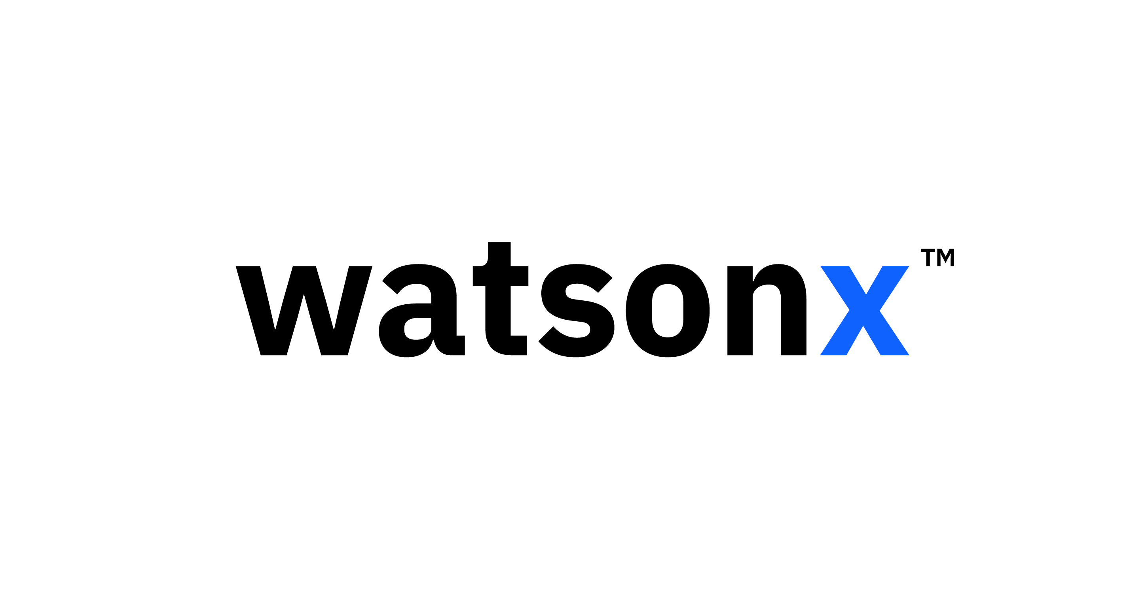







For the past decade, IBM Consulting has offered AI and automation solutions to optimize business process and IT operations across industries. Now, IBM is actively working with watsonx and our ecosystem partners to apply generative AI to accelerate how we solve those business problems — reducing costs and turnaround time, improving productivity, and delivering new experiences for clients and their customers.
What IBM offers
IBM Consulting is the expert partner for your AI transformation journey
21K+
and growing, skilled data and AI practitioners
~2K
AI use cases developed for clients in 2022, 40K+ AI and analytics engagements
70%
successful deployment rate for projects (vs. industry average of 54%)
1,250
active and ongoing AI client engagements worldwide in 2022
1K+
and growing, Consultants skilled in generative AI with certification plans across IBM and partner technologies
15K+
enterprise strategy and designer consultants to support an experience-led approach to maximize adoption
Source: IBM internal data
Notes:
IBM Consulting takes an open and collaborative approach to plan, build, implement, and operationalize generative AI solutions that embrace multiple models on multiple clouds from industry leaders. An open ecosystem approach helps clients define the right models and the right architecture to deliver the best outcomes. IBM Consulting has unique skills across IBM technology, but also works closely with a diverse AI partner ecosystem, including Adobe, Amazon Web Services (AWS), Microsoft, Salesforce, SAP, a myriad of open-source technologies, and more to help ensure clients benefit from the technology solution that best meets their needs.
IBM Consulting has established a Center of Excellence (CoE) for Generative AI. It stands alongside IBM Consulting’s existing global AI and Automation practice, which includes 21,000 data and AI consultants who have conducted over 40,000 enterprise client engagements. This CoE already has more than 1,000 consultants (as of 4Q23) with specialized generative AI expertise that are engaging with a global set of clients to drive productivity in IT operations and core business processes like human resources (HR) and marketing, elevate their customer experiences, and create new business models.
Examples of CoE projects delivering AI-generated spoken sports commentary to millions of fans at The Masters¹ (and Wimbledon),² combining generative AI with IBM Watson to verify the discovery of new applications of Mitsui Chemicals³ products and applying generative AI in the customer relationship process at Bouygues Telecom.⁴ In this early work applying foundation models (FMs), IBM Consulting has seen some clients experience up to 70% acceleration in time-to-value with FMs, as compared to traditional AI approaches.
References:
Data points on the slide are from IBM Consulting internal data.
¹IBM Brings Generative AI Commentary and Hole-by-Hole Player Predictions to the Masters Digital Experience, IBM, March 2023: https://newsroom.ibm.com/2023-03-28-IBM-Brings-Generative-AI-Commentary-and-Hole-by-Hole-Player-Predictions-to-the-Masters-Digital-Experience
²IBM Brings Generative AI Commentary and AI Draw Analysis to the Wimbledon Digital Experience, IBM, June 2023: https://newsroom.ibm.com/2023-06-21-IBM-Brings-Generative-AI-Commentary-and-AI-Draw-Analysis-to-the-Wimbledon-Digital-Experience
³Combining Generative AI with IBM Watson, Mitsui Chemicals Starts Verifying New Application Discovery for Agility and Accuracy, IBM, May 2023: https://newsroom.ibm.com/2023-05-25-Combining-Generative-AI-with-IBM-Watson,-Mitsui-Chemicals-Starts-Verifying-New-Application-Discovery-for-Agility-and-Accuracy
⁴AI for everyone - Bouygues Telecom achieves rapid innovation by scaling AI on AWS, IBM, February 2022: https://www.ibm.com/case-studies/bouygues-telecom

Slide 38

What IBM offers
Delivering value and business transformation – powered by hybrid cloud, AI and an open ecosystem of partners
The only major global consultancy that sits within a technology company: IBM shapes solutions side by side with clients — with principles grounded on open innovation and trust. It’s why IBM doesn’t just advise but invents and builds what's next across industries and domains, together with our clients and partners.
Guided by IBM’s trusted AI principles:
The purpose of AI is to augment, not replace, human intelligence
Data and insights belong to their creator
Technology must be transparent and explainable
Finance, Supply Chain, Procurement
Human Resources
Marketing
Customer Service
IT
Automation
Application Modernization
Security and Sustainability
IBM Consulting AI Services End-to-end capabilities to transform enterprise functions with generative AI driven workflows
IBM Consulting Garage for Generative AI Rapidly apply generative AI to new and existing use cases through a proven, value-measured engagement model
to drive transformation and scale solutions across the enterprise
IBM Consulting Advantage
Delivered to you consistently and at optimized value through a services platform that includes proprietary methods,
purpose-built AI assets and models, and role-based generative AI assistants using IBM and partner technology
Ask Procurement
Collections Query Assistant
Source-to-Pay
askHR
CourseCreator
Marketer’s workbench
Headline assistant
Creative assistant
Omnichannel virtual agent
Agent assistant dashboard
Banking copilot (KYC)
Incident workflow management
IT operations third eye
SAP playbook automation
App dev modernization assistants
Mainframe modernization
IBM Consulting Cloud Accelerator
Notes:
IBM Consulting is the only major global consultancy that sits within a technology company. Together with clients, IBM Consulting conceptualizes and builds solutions for clients in all industries and domains, leverage ecosystem partners. IBM’s AI principles of trust guide the development of these solutions.
IBM Consulting provides the following services:
IBM Consulting AI Services
IBM Consulting Garage for Generative AI
IBM Consulting AI Accelerator
Reference:
IBM AI Ethics: https://www.ibm.com/impact/ai-ethics

Slide 39

What IBM offers
Meeting clients where they are requires first understanding their progress along the AI journey
IBM Consulting is the expert partner for your AI transformation journey: our approach
Advise
Design, build, and pilot
Roadmap and business case
Operate and scale
Opportunity areas
Potential use cases
Future-state journeys
AI techniques, model selection
Roadmap
Talent strategy
Business transformation office and governance
Prioritized use cases
Value case
Tech and data strategy/ architecture
Operating model
Business case
Change plan
Ecosystem partner alignment
Proofs of concept (POCs)
1. Conduct top-down assessment across all enterprise or domain business functions to identify high potential areas aligned to strategy
2. Identify high potential workflows in priority business components and quantify high-level value at stake
3. Re-imagine AI driven workflows leveraging design techniques
4. Identify AI techniques and design future state tech, data, and op model
5. Develop AI transformation roadmap and value case
6. Establish governance and transformation/ value orchestration office to guide transformation and value realization
Realize target value at scale & transform E2E
Notes:
IBM Consulting partners with clients to help them with their AI transformation journey. IBM Consulting advises clients to help prioritize use cases, design, build, and pilot AI solutions. They also work with clients to create an overall AI strategy and roadmap to help their businesses’ scale AI solutions.
Specifically, IBM Consulting helps clients:
Conduct top-down assessment across all enterprise or domain business functions to identify high potential areas
aligned to strategy
Identify high potential workflows in priority business components and quantify high-level value at stake
Re-imagine AI driven workflows leveraging design techniques
Identify AI techniques and design future state tech, data, and op model
Develop AI transformation roadmap and value case
Establish governance and transformation/value orchestration office to guide transformation and value realization

Slide 40
Getting started
IBM can help clients along their AI transformation journey to unlock value at-scale
from rapid activation in a “no regrets” pilot to a holistic transformation effort
Activate the organization with ‘no regret’ generative AI pilots
Transform the business and scale value-capture
This month Set exploratory strategy, prioritize initial use case(s), formulate tech & data strategy, scope pilots
1–2 month horizon
Launch and complete pilots, establish value proofs
2-3 month horizon
Transition top pilots to production implementation, in alignment with a well-defined generative AI strategy
6-12 month horizon
Build foundational capabilities required to successfully leverage generative AI at-scale
12-18 month horizon
Scale value capture by transforming multiple production workflows and experiences across the enterprise
Notes:
This slide outlines the watsonx pilot program and the various steps and timing associated at each phase of an IBM assistant project. Clients can get started, deploy AI solutions, and scale an AI strategy in just 12-18 months. Specifically:
In 1-month, clients can set an exploratory strategy, prioritize initial use case(s), formulate tech and data strategy, scope pilots.
In 1-2 months, clients will be ready to launch and complete pilots, that establish value proofs.
In 2-3 months, organizations can then transition top pilots to production implementation, in alignment with a well-defined generative AI strategy.
In 6–12-months, clients will have built foundational capabilities required to successfully leverage a generative AI at-scale.
By 12-18 months, a business will be ready to scale value capture by transforming multiple production workflows and experiences across their enterprise.

Slide 41
Getting started
Three ways to get started with watsonx today
IBM’s investment in partnering with clients
Free trial
Core watsonx.ai and watsonx.data features to start building AI models and accessing data across your organization.
Client briefing
Discussion and custom demonstration of IBM’s generative AI watsonx point of view and capabilities. Understand where generative AI can be leveraged now for impact in your business.
2-4 hours onsite or virtual
Pilot program
Engagement with an IBM multi-disciplinary team to jointly innovate and rapidly prove the business value of generative AI solutions using watsonx.
1-4 weeks
Available now
Notes:
This self-explanatory slide provides information on how clients can get started with watsonx and watsonx.ai. Clients can try out the product for free, request a client briefing, or join the pilot program.
Note to IBMers: Pilot program details are available here: https://ibm.biz/watsonxPilotProgram.

Slide 42
Notes:
This slide is self-explanatory and does not require speaker notes.

